Slide 1
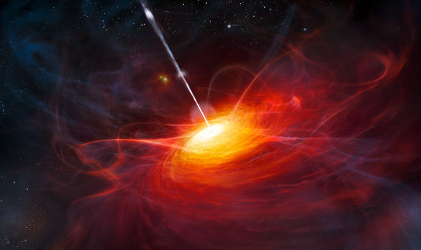
Studies of quasar optical variability: anything beyond stochastic?
Yong Shi (Nanjing University)
Notes:
Hello everyone, I am Yong Shi from Nanjing University. I am really glad to attend this workshop. It is so exciting to see more close collaborations between China and Caltech.
Today I will talk about some of my thoughts of using P200 to understanding the nature of quasar variability. With the advent of ZTF and LSST, time-domain surveys will discover many new phenomena about quasar variability. And the ground-based spectra will be the key to get insights into those new discoveries. In this talk, I will mainly present some interesting examples to highlight the importance of ground-based spectra in understanding the quasar variability.

Slide 2
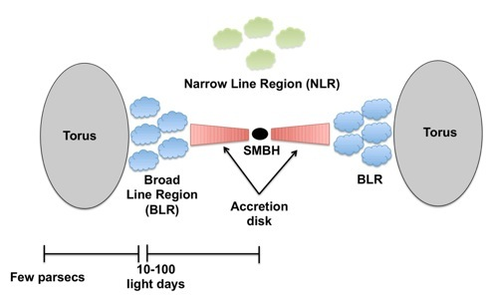
Introduction
Quasars are long known to be variable across the EM.
➔A powerful tool to understand the central engine and its surrounding material structures (jets, accretion disks, BELR, dusty torus…)

Slide 3
Introduction
The nature of central engines:
size=cΔt ➔ SMBH as the central engine.
reverberation mapping→ SMBH masses.

Slide 4
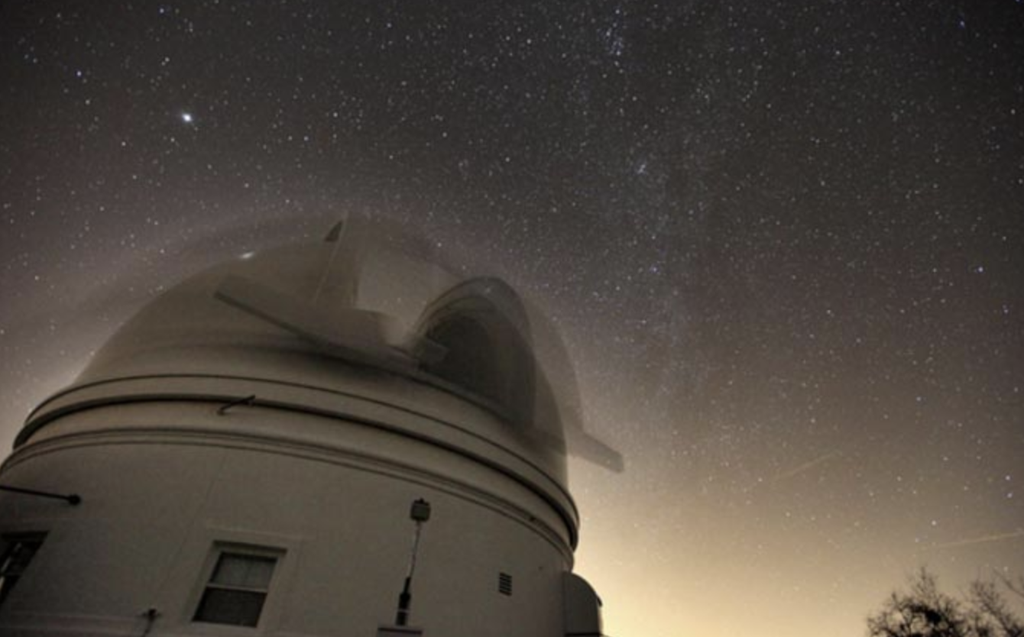
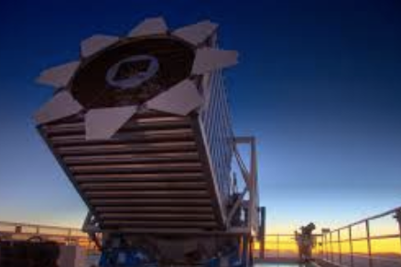
Introduction
The optical variability
SDSS
CRTS
Pan-STARRS
Dedicated programs
ZTF
LSST
Dedicated programs

Slide 5
Our quasar variability project
Project: Studies of quasar variability: anything beyond stochastic?
Facility: LCO network 1-m telescopes.
Targets: 100 radio-loud quasars + 100 radio-quiet quasars.
Observing mode: 10 day cadence + 22 mag (5-σ, r-band) + 7 month duration per year.
Duration: 2015-2018
Some interesting sources start to show up!

Slide 6
Our quasar variability project
The optical variability:
stochastic processes.
other processes
Change in the accretion state;
Obscuration by moving dusty clouds;
Periodic signal from SMBH binaries;
Supernovae in accretion disks;
Tidal disruption events;
Micro-lensing;
…

Slide 7
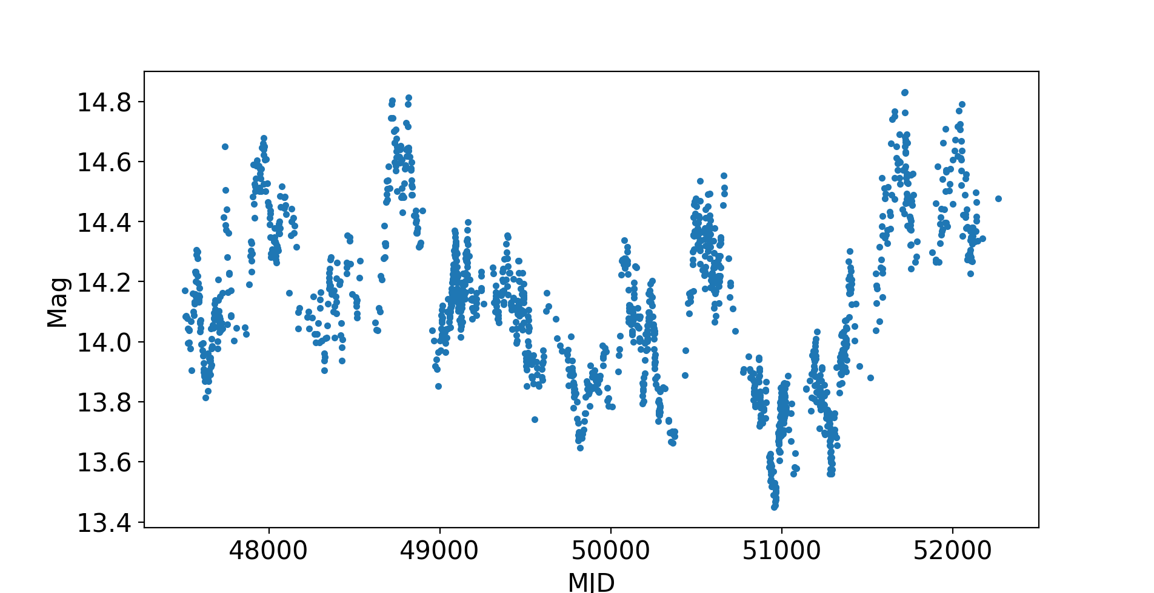
Stochastic Processes
NGC 5548
AGN Watch Project (Ohio state)

Slide 8
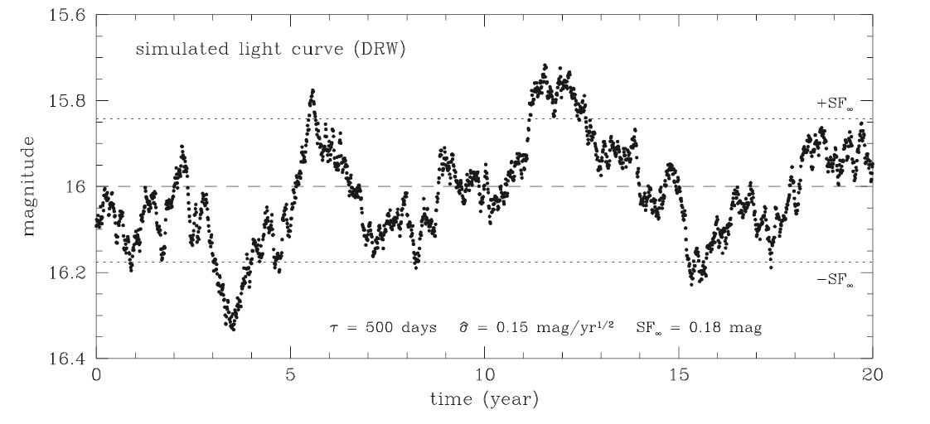
Stochastic Processes
Models of Damped Random Walks
Kelly et al. (2009)

Slide 9
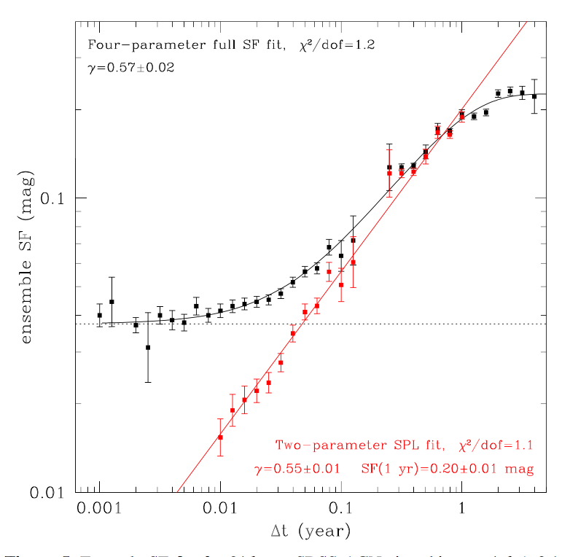
Stochastic Processes
Structure Function:
SF (mag)
Δt(years)

Slide 10
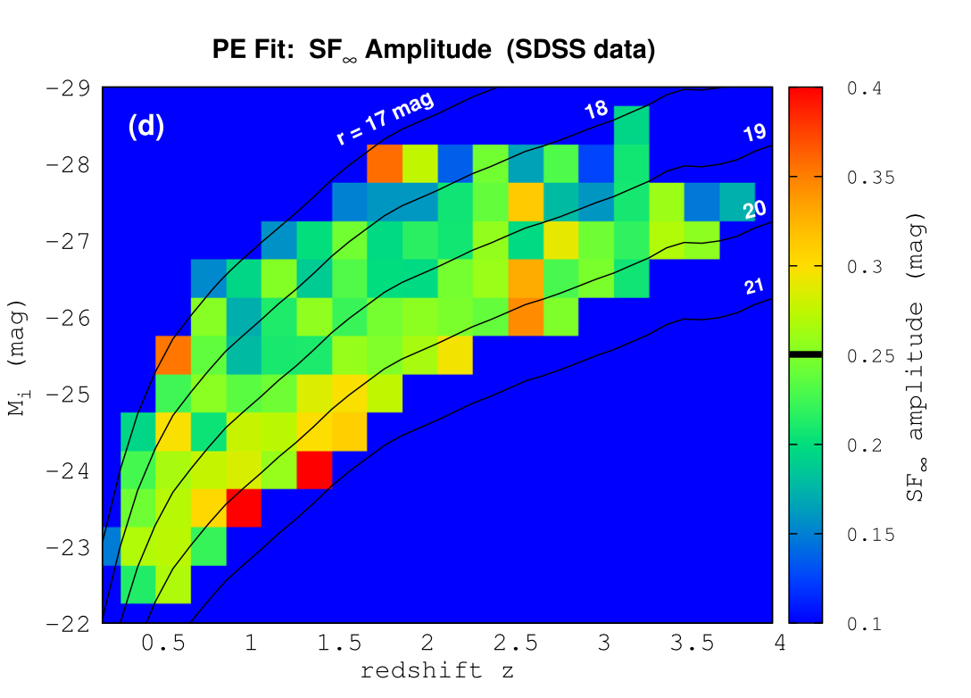
Stochastic Processes
Sripe-82 SDSS quasars: the typical variability
amplitude is 0.2 mag.
MacLeod et al. (2010)

Slide 11
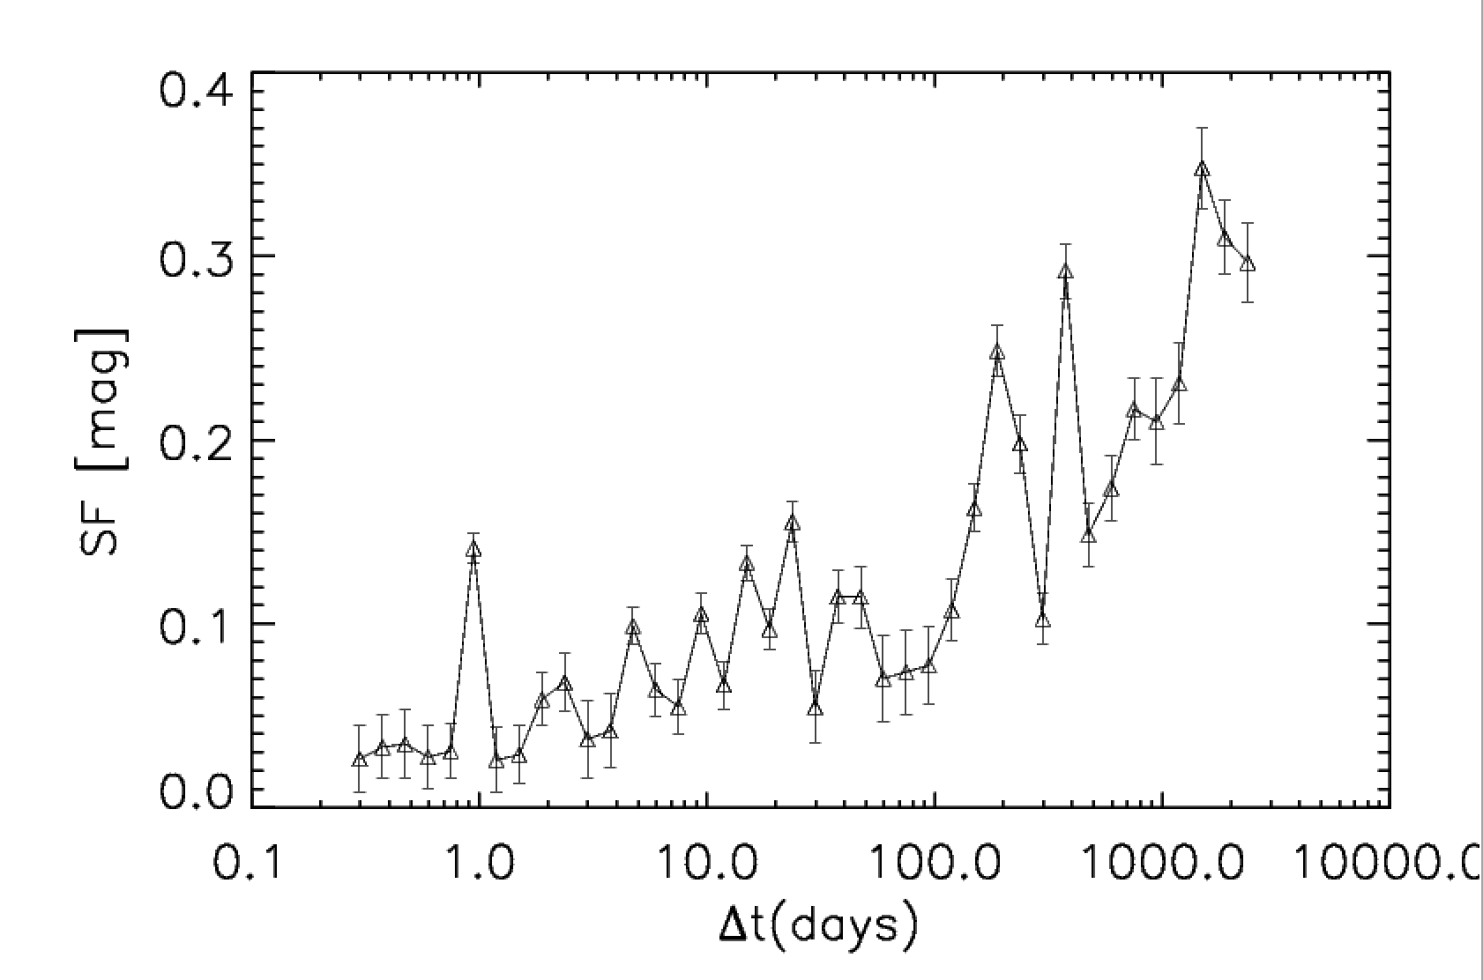
Stochastic Processes
Our ensemble SF of 50 RL quasars shows some deviations from the random walk (Zhuang, YS et al. 2018 in preparation)
Zhuang, YS et al. 2018 in preparation

Slide 12
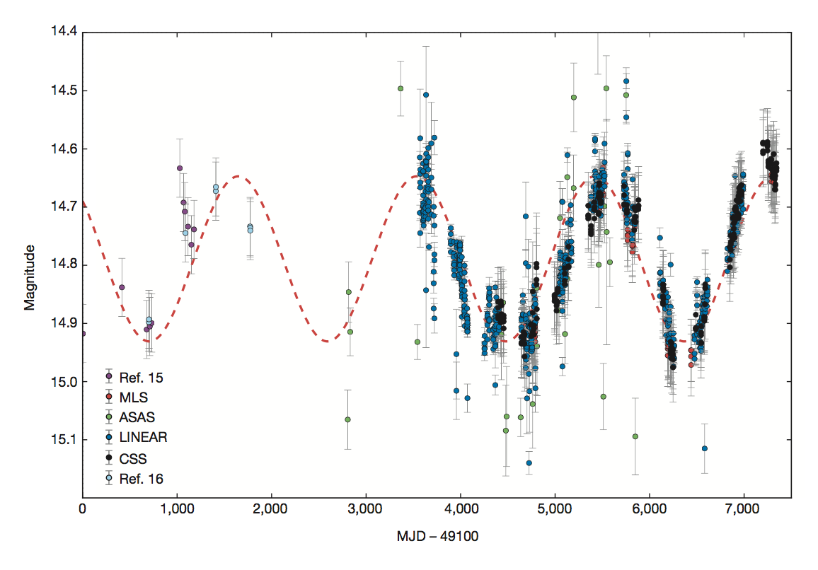
SMBH Binaries?
PG 1302-102:
a periodically variable source;
the best one among 243500 CRTS quasars.
PG 1302-102
(Graham et al. 2015 Nature)

Slide 13
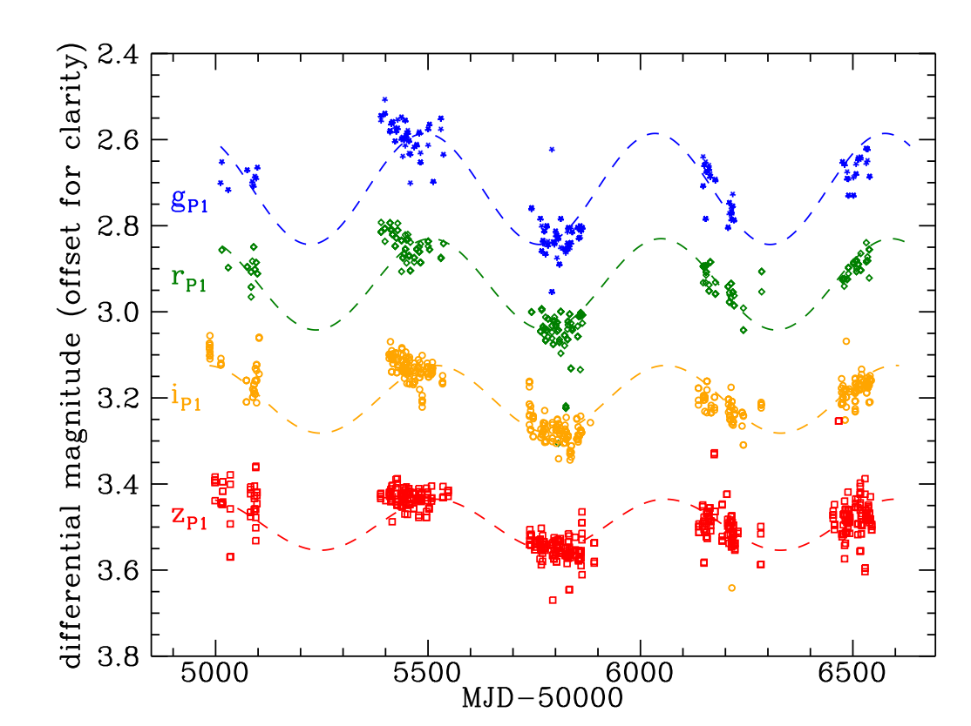
PSOJ334.2028+01.4075:
a periodically variable source;
the best one in Pan-STARRS1 medium deep survey.
Liu et al. 2015

Slide 14
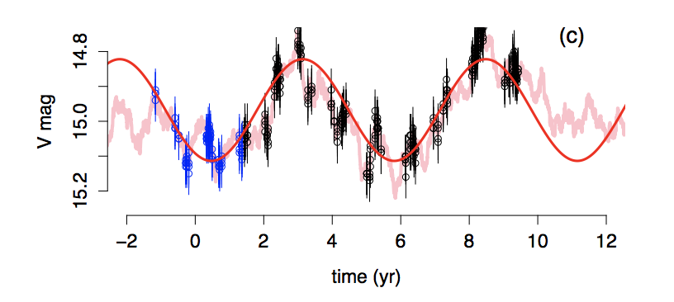
SMBH Binaries?
High false-positive rate for < 5 cycle coverage!
Black symbols: CRTS data-points, Blue symbols: LINEAR data-points.
Red curve: best-fitted sinusoid.
Pink Curve: A random-walk light curve.
Vaughan et al. 2016

Slide 15
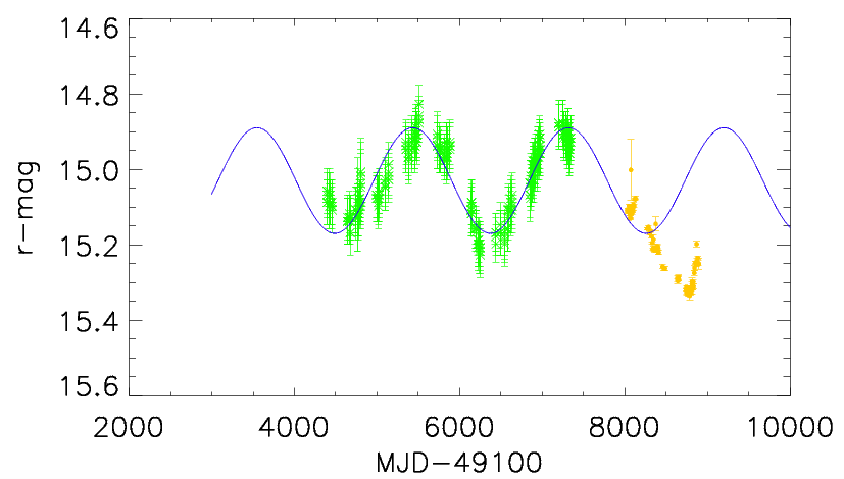
SMBH Binaries?
Our follow-up monitor disfavor the periodic variation of PG1302-102 (YS 2018a in preparation)

Slide 16
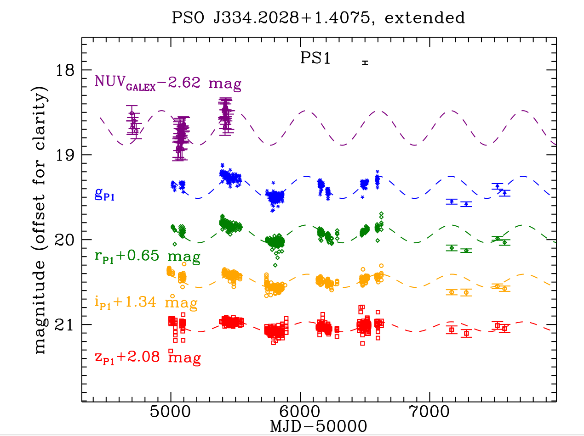
SMBH Binaries?
Extended monitor of PSOJ334 disfavors the periodic variation too.
Liu et al. 2016

Slide 17
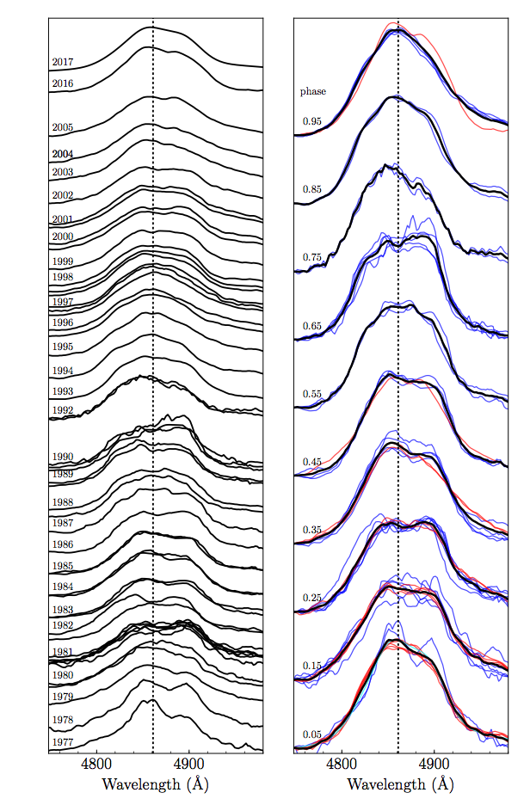
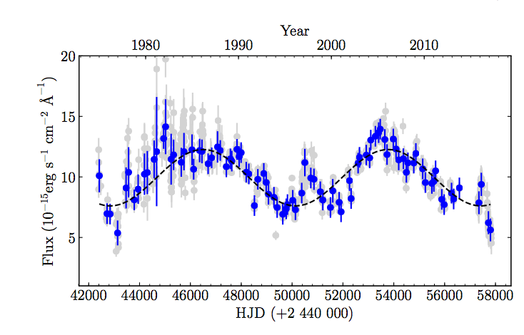
SMBH Binaries?
Photometric + spectroscopic monitor significantly reduce false-positive!
Ark 120
Li, Wang et al. 2017

Slide 18
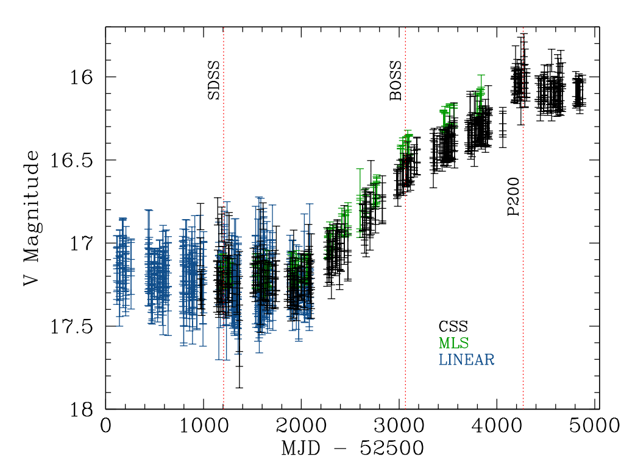
Extreme variability quasars
1 out of 10⁴ in the CRTS survey.
500 days (rest-frame)
Stern et al. (2007)

Slide 19
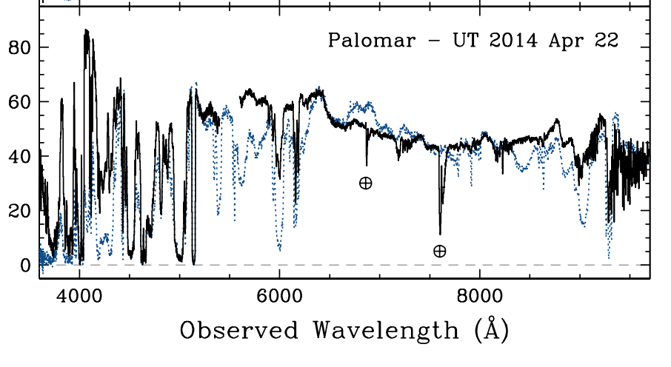
Extreme variability quasars
Spectra data favor:
the change in the accretion state
the variable obscuration
✔
✖
Stern et al. (2007)

Slide 20
Extreme variability quasars
The change in the accretion state is favored for both
Individual EVQs:
Mrk 590 (Denney et al. 2014)
SDSS J015957.64+003310.5 (LaMassa et al. 2015)
HE 1136-2304 (Parker et al. 2016)
SDSSJ1011+5442 (Runnoe et al. 2016)
SDSSJ012648.08−083948.0 (Ruan et al. 2016)
SDSSJ233602.98+001728.7 (Ruan et al. 2016)
10 more examples by MacLeod et al. 2016
21 more by Yang et al. 2017.
and statistical studies of EVQs:
Rumbaugh et al. 2017

Slide 21
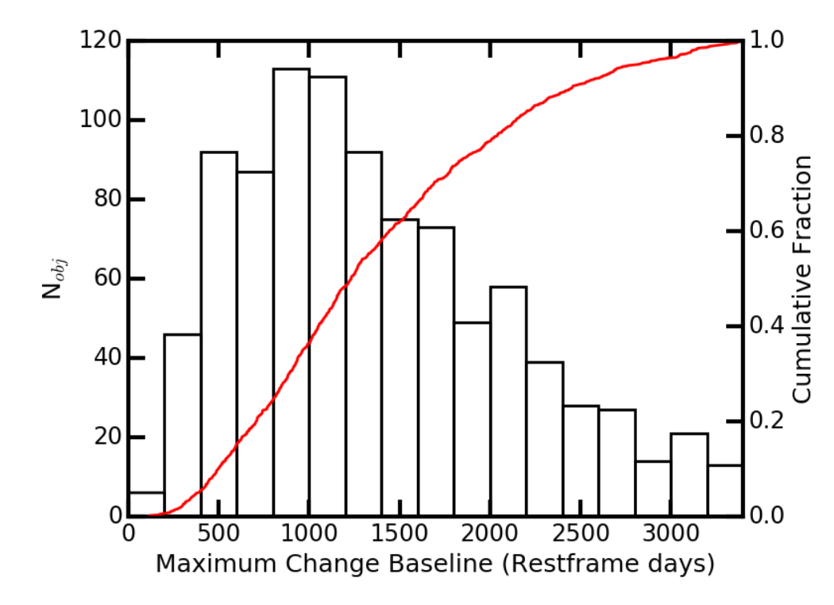
Extreme variability quasars
A discovery of one of the most extremely variable quasars (YS et al. 2018b in preparation):
ΔT=140 days, Probability < 10⁻⁴ based on SDSS
Rumbaugh et al. 2017
ΔT over which Δm > 1 mag.

Slide 22
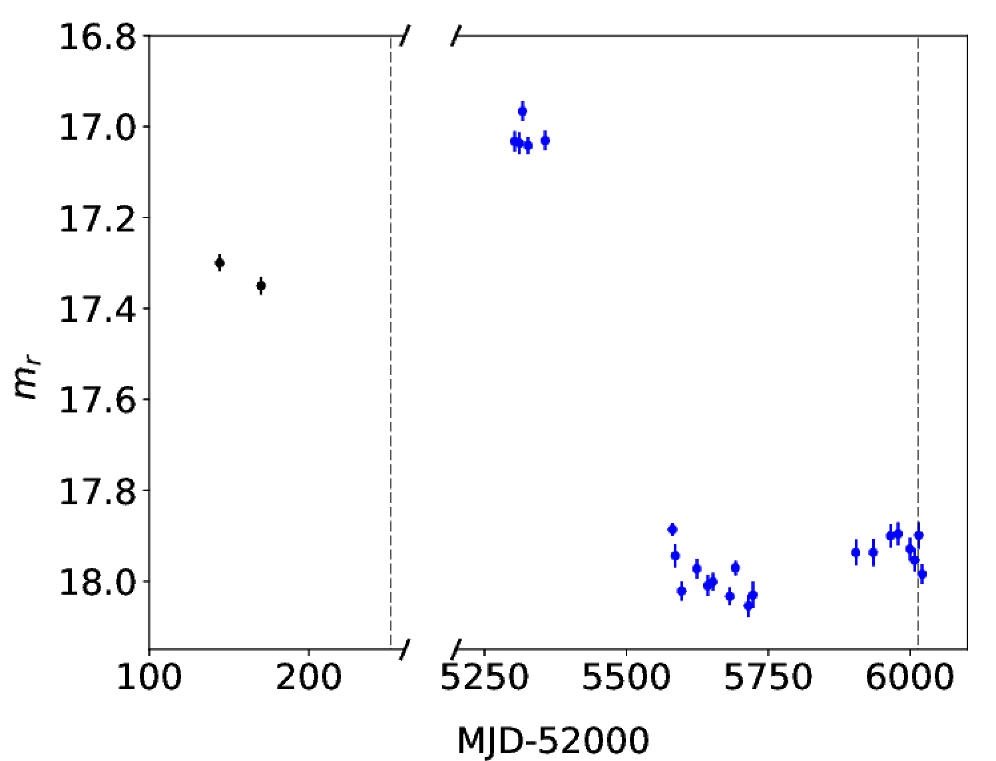
Extreme variability quasars

Slide 23
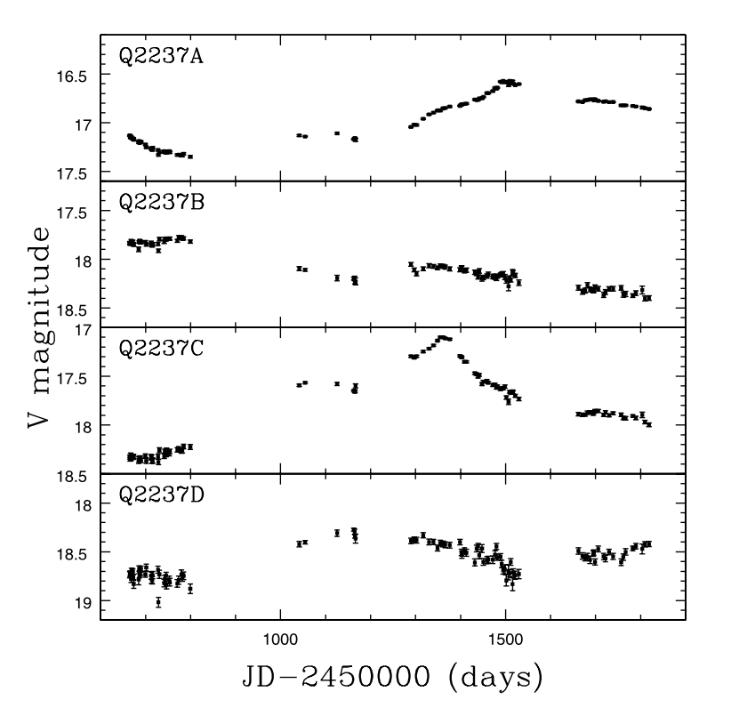
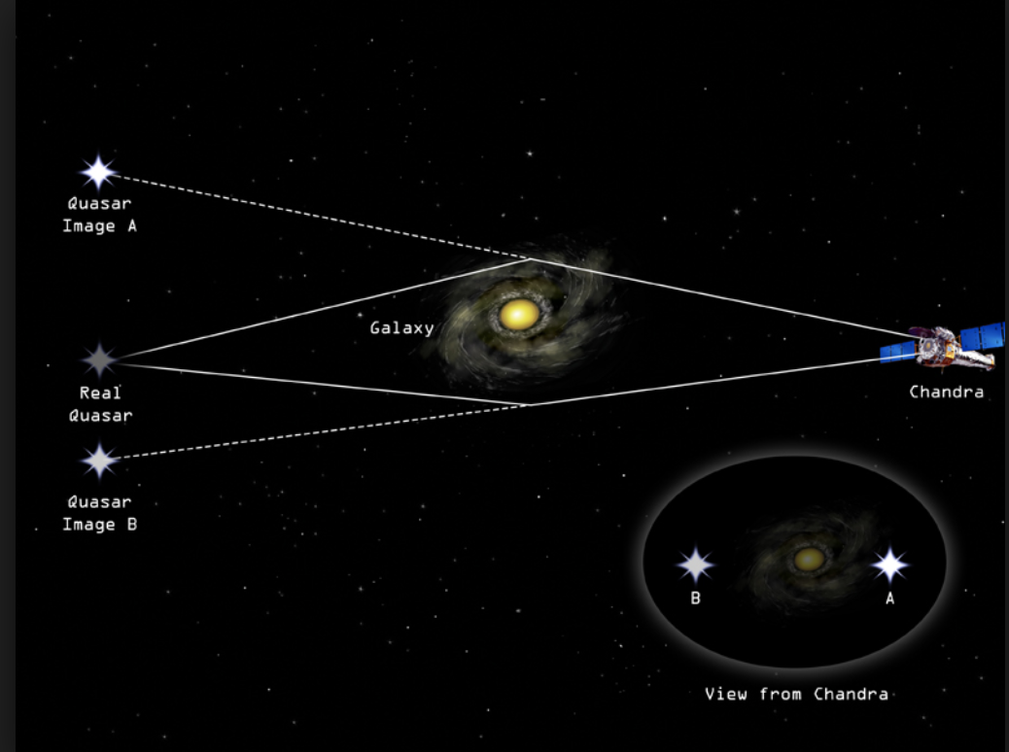
Micro-lensing, TDE, supernova
In macro-lensed multiple quasars, micro-lensing-caused variability is seen.
Q2237+0305 (Wozniak et al. 2000a, b)

Slide 24
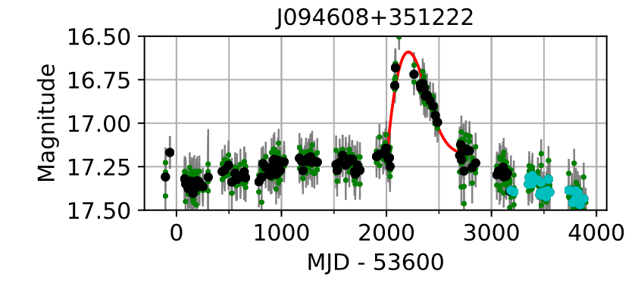
Micro-lensing, TDE, supernova
In a single quasar, it is very difficult to differentiate the micro-lensing variability from the intrinsic variability.
A flare
Graham et al. 2017

Slide 25
SUMMARY
With the advent of ZTF and LSST, the time-domain studies of quasar variability will enter the golden era.
We started a dedicated program to study the quasar’s optical variability, with some interesting candidates showing up.

