Slide 1
The CIV Blueshift, its Variability, and its Dependence Upon Quasar Properties: Insights from SDSS-RM
EAAGN WORKSHOP 2017, Kagoshima, Japan
Mouyuan Sun (孙谋远)
Center For Astrophysics, USTC
Co-authors: Yongquan Xue (USTC), G. T. Richards (Drexel U.), J. R. Trump (UConn), Yue Shen (UIUC), W. N. Brandt (PSU), D. P. Schneider (PSU)

Slide 2
Outline
Motivation
The importance of CIV blueshift
The advantages of SDSS-RM
Sample selection
Results
HeII1640 vs CIV
CIV blueshift and line profile
The variability of line center
CIV blueshift and quasar properties
Future prospects

Slide 3
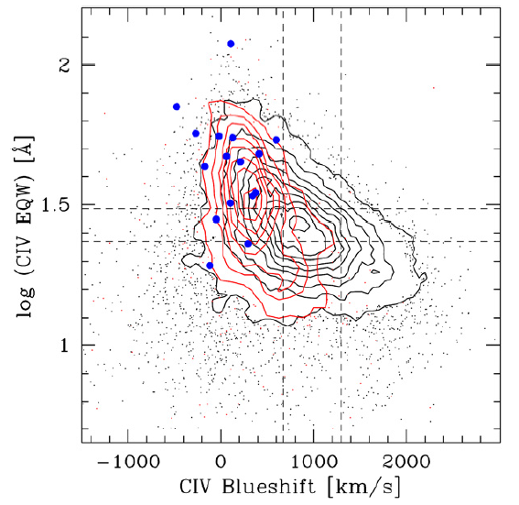
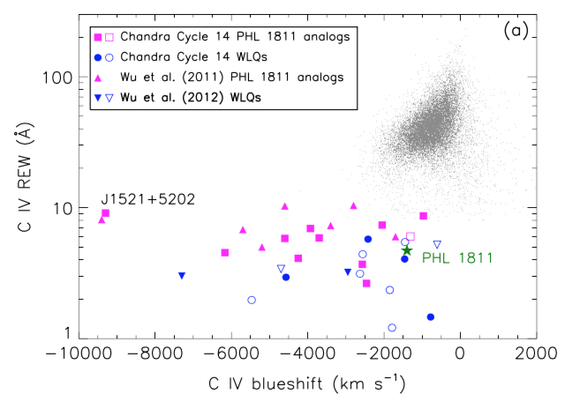
Motivation: The importance of CIV blueshift
High-ionization lines (HILs, e.g., CIV) are systematically blueshifted with respect to low-ionization lines (LILs, e.g., MgII).
Intrinsically X-ray weak quasars are extremely blueshifted!!!
The current RM sample is far from complete. We can learn the possible bias from the CIV blueshift.
Luo2015
Blue: RM AGNs
Richards2011

Slide 4
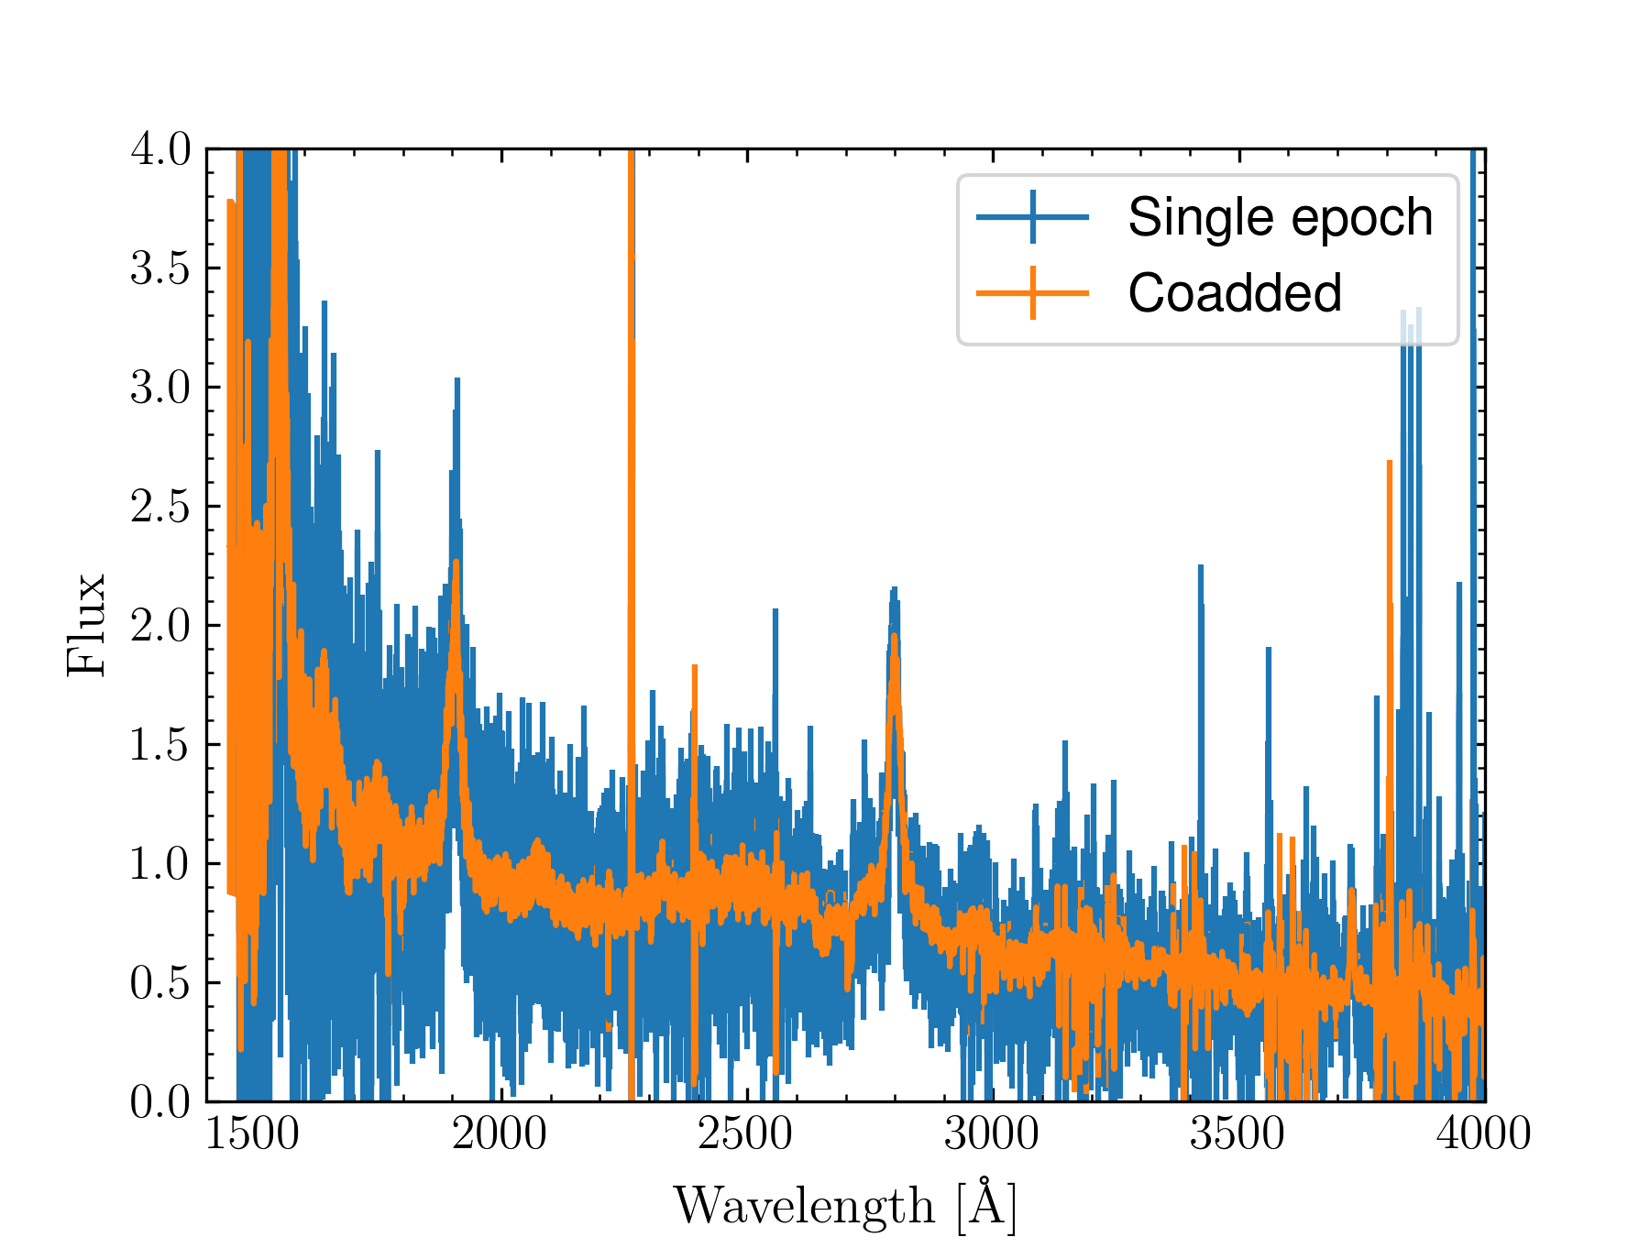
Motivation: The advantages of SDSS-RM
High S/N coadded spectra

Slide 5
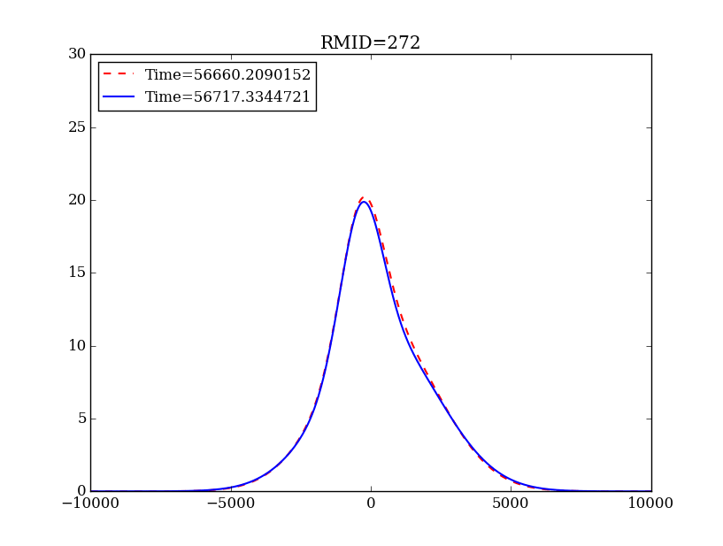
Motivation: The advantages of SDSS-RM

Slide 6
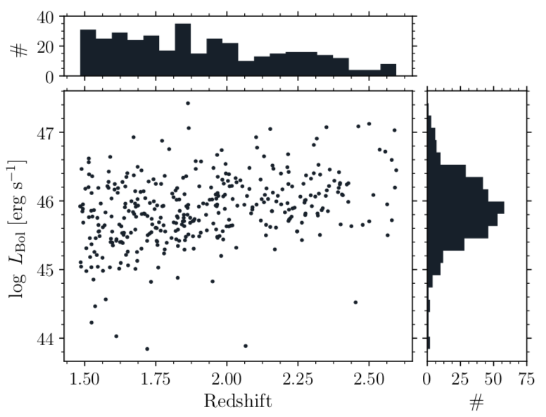
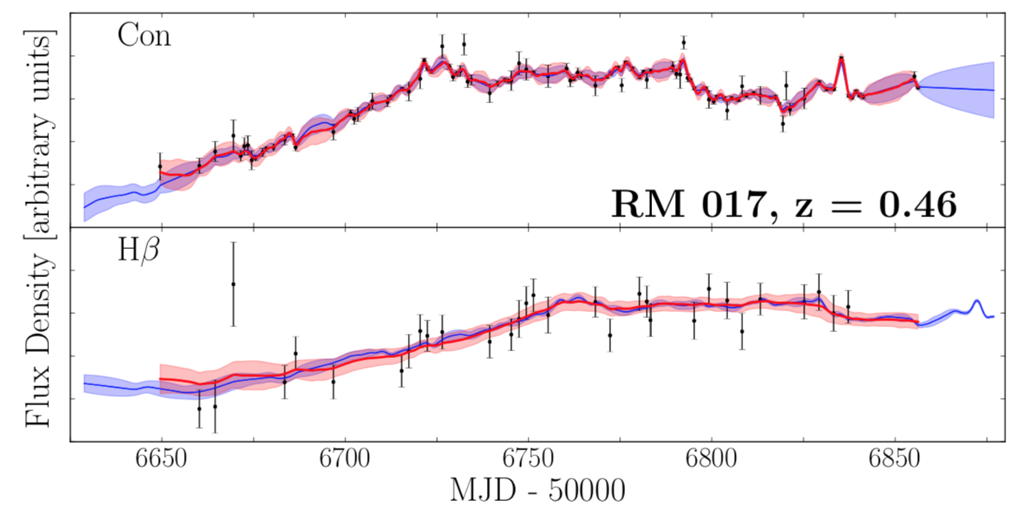
Sample selection
Parent sample: SDSS-RM
Simultaneously measure CIV and MgII (according to Shen2016, MgII is the best practical redshift estimator for this redshift range)
362 quasars, Lbol spans two orders of magnitude
Measured line center and other quasar properties
AEGIS
Grier+2017

Slide 7
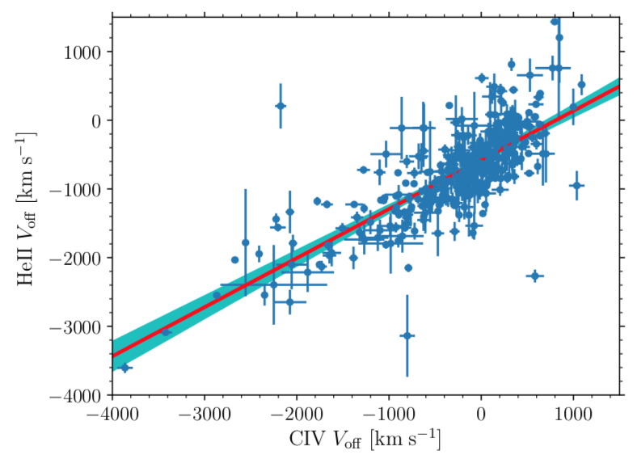
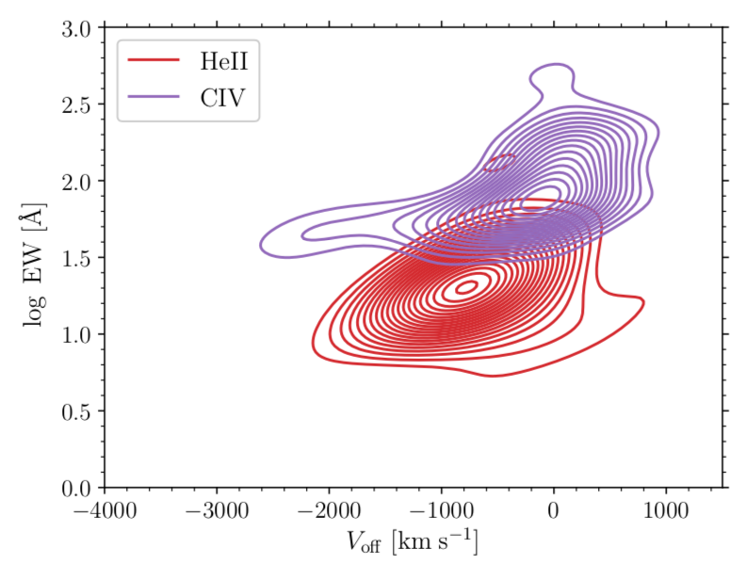
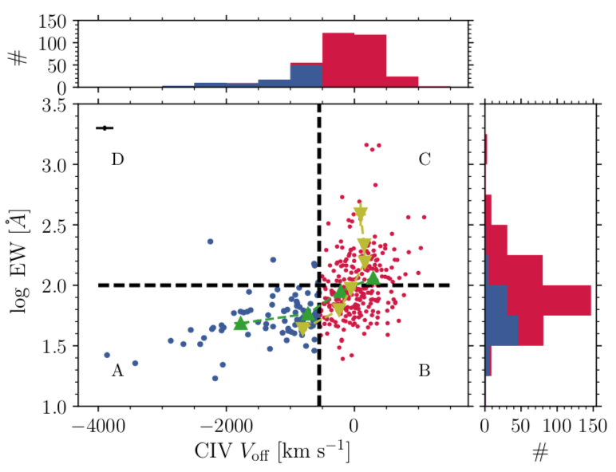
Results: HeII vs CIV
Negative value indicates blueshift
Offset velocity with respect to MgII
High blueshift, weak line: CIV blueshift <-500 km/s; log EW < 2
Low blueshift, weak line: CIV blueshift >=-500 km/s; log EW < 2
Low blueshift, strong line: CIV blueshift >=-500 km/s; log EW > 2
HeII blueshift and CIV blueshift are correlated

Slide 8
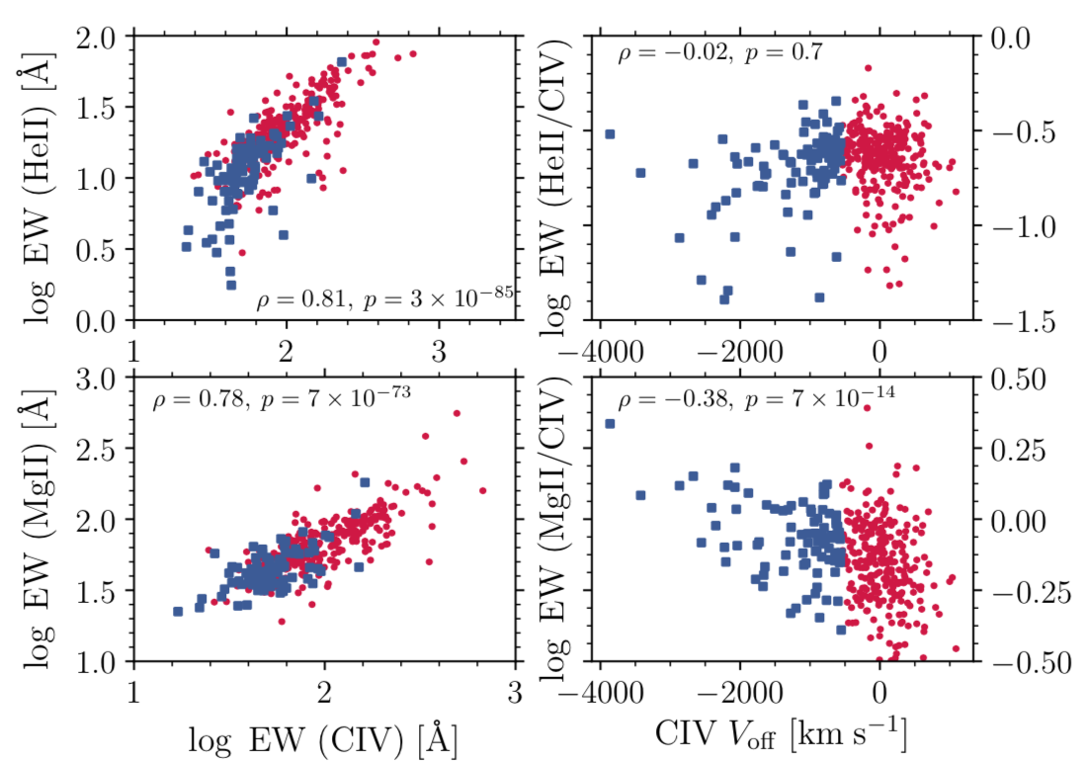
Results: HeII vs CIV
$$EW=covering_{−}factor∗Lion/L_{UV}$$
The ratio of CIV EW to HeII EW does not depend on blueshift (both CIV and HeII are HILs);
The ratio of MgII EW to CIV EW increases with blueshift (i.e., for high-blueshift sources, HILs, e.g., CIV, are preferentially suppressed)
Lion(10eV)/Lion(50eV) increases (i.e., softer SED) with CIV blueshift
Covering_factor(LIL)/Covering_factor(HIL) increases with CIV blueshift

Slide 9
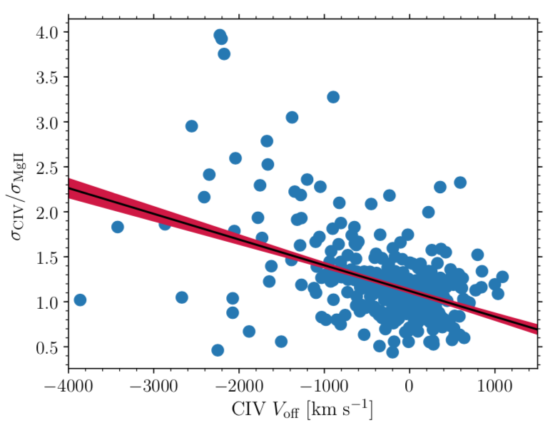
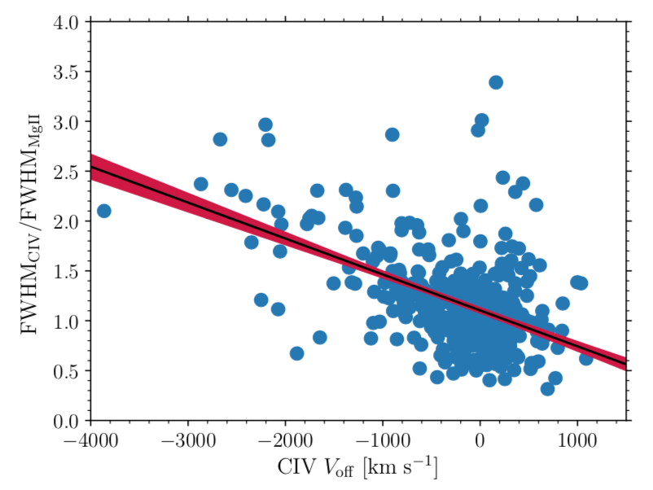
Results: CIV blueshift and line profile
MBH(CIV) is a biased estimator
Can be corrected using these correlations

Slide 10
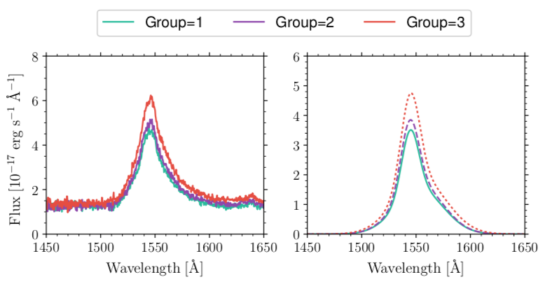
Results: The variability of CIV blueshift

Slide 11
Results: The variability of CIV blueshift
Definition:
Observed variance
Variance due to measurement errors
Dynamical timescale of BLR:
Much longer than the SDSS-RM baseline
The observed variability is likely due to the variations of Lion

Slide 12
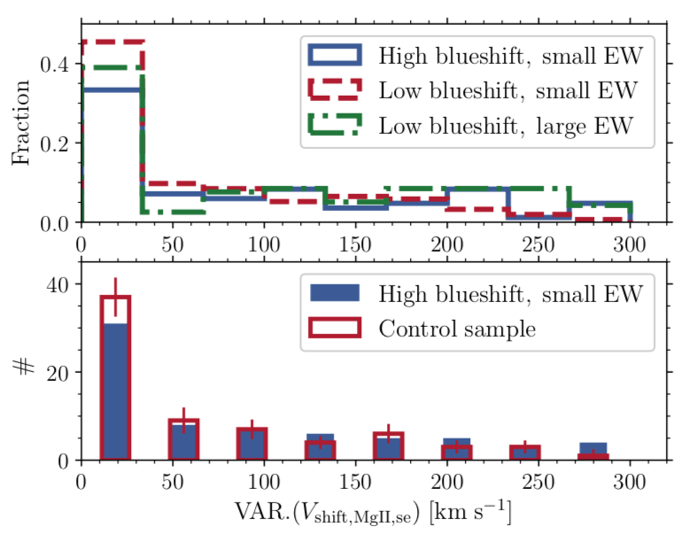
Results: The variability of line center
MgII
High blueshift, weak line: CIV blueshift <-500 km/s; log EW < 2
Low blueshift, weak line: CIV blueshift >=-500 km/s; log EW < 2
Low blueshift, strong line: CIV blueshift >=-500 km/s; log EW > 2
Control sample: similar EW (or quasar luminosity) and z
The accuracy of MgII-based
redshift is limited
The control sample is slightly
less variable

Slide 13
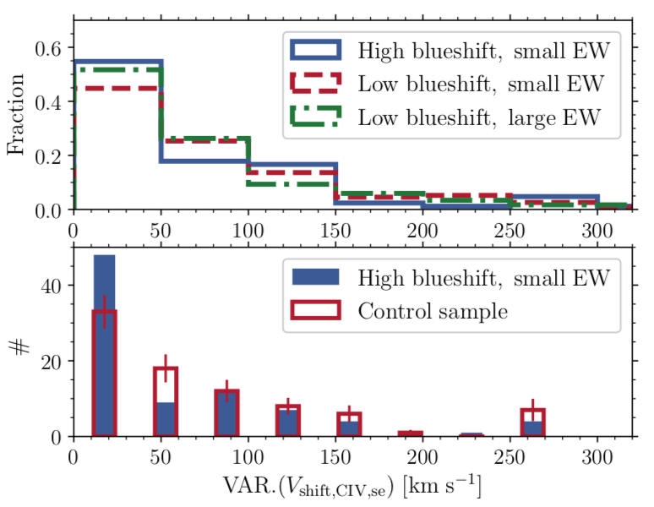
Results: The variability of line center
CIV
High blueshift, weak line: CIV blueshift <-500 km/s; log EW < 2
Low blueshift, weak line: CIV blueshift >=-500 km/s; log EW < 2
Low blueshift, strong line: CIV blueshift >=-500 km/s; log EW > 2
Control sample: similar EW (or quasar luminosity) and z but with low blueshift
Unlike MgII, the control sample
is more variable for CIV.
HIL gas and LIL gas are different
in terms of the kinematics.

Slide 14
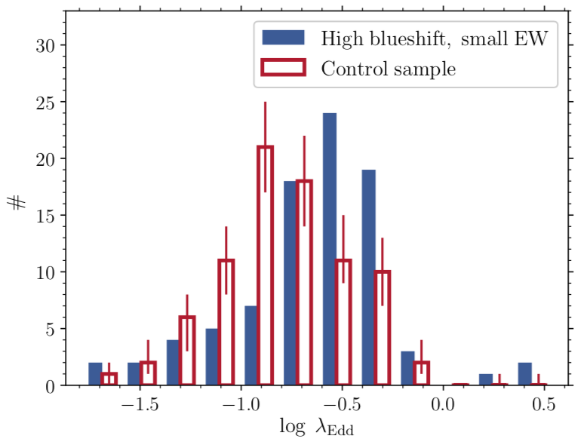
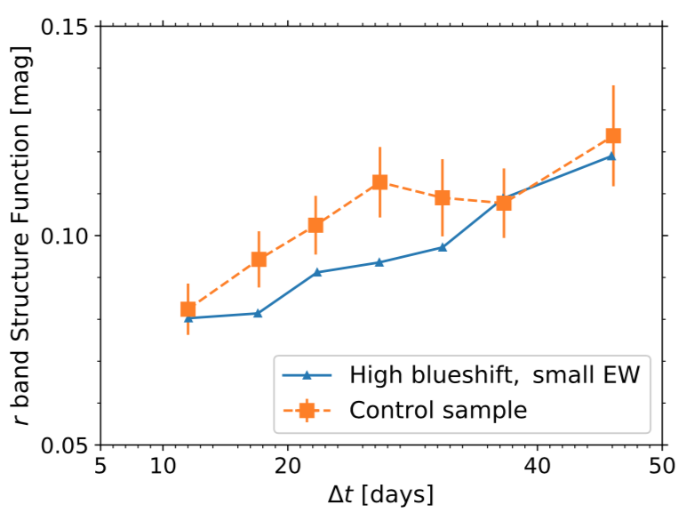
Results: CIV blueshift vs quasar properties
Control sample: similar EW (or quasar luminosity) and z but with low blueshift
High blueshift sources are more active
or more edge on (thereby have small line width, small MBH)?
High blueshift sources are more active
or more edge on (thereby have small line width, small MBH)?
High blueshift sources
are less variable
Log Edd ratio = log [ Lbol / MBH(MgII) ]

Slide 15
CIV blueshift: the Eddington ratio scenario
Higher Eddington ratio
Disk is more stable (i.e., lower variability)
Softer spectral energy distribution
More UV photons, less X-rays (i.e., more easily to drive wind)
More ~ 10eV ionizing continuum, less ~ 50 eV one (i.e., stronger MgII, weaker CIV)
$R_{BLR}\sim L_{ion}^{0.5}−−>V_{line}^{2}\sim \frac{1}{R}\sim L_{ion}^{−0.5}$ (i.e., broader CIV, narrower MgII)

Slide 16
Future prospects
It’s vital to select a representative sample (i.e., covers the full CIV blueshift range) from future RM experiments, e.g., SDSS-RM, OzDES-RM or PFS-RM.
Richards2011

