Slide 1
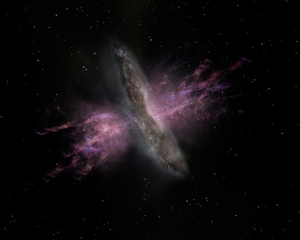
Kinematic Size-Luminosity relation of AGN Outflows
Daeun Kang
&
Jong-Hak Woo
(Seoul National University)
2017 East Asia AGN Workshop @ Kagoshima, Japan, 2017. 12. 4 ~ 6
Notes:
(18, 18)
Good morning. I’m Daeun Kang who are working on the master’s degree in SNU of Korea.
I want to say Thank you for giving me a great opportunity to present a talk here.
Today I’ll talk about the kinematically defined size of an area where ionized gas suffers from AGN driven outflows.

Slide 2
AGN driven Ionized Gas outflow in NLR
Outflow is presented by blue/red-shifted broad component in emission line
e.g., Boroson (2005), Crenshaw et al. (2010), Bae & Woo (2014)
[OIII] 5007Å : widely used tracer of AGN NLR
e..g., Bennert (2005), Greene et al. (2011), Harrison et al. (2014), Bae et al. (2017)
Ionized gas in NLR : Gravitational potential of host galaxy + AGN driven outflow
e.g., Woo et al. (2016), Karouzos et al. (2016a, b), Kang et al. (2017)
Kang & Woo (2018, in preparation)
Notes:
It has been observed in emission line spectra that ionized gas in NLR which is Kpc scale far from SMBH suffers from outflow.
The outflow feature is presented by blue-or-red shifted, broad component in the line profile, as we can see in these Figures.
This outflow component is commonly observed in the [OIII] 5007 angstrom which is a widely used tracer of NLR, and also
it is observable in Balmer emission lines like Ha and H-beta.
This broad asymmetric line profile tells us that ionized gas in NLR not only traces the gravitational potential of host galaxy but also is influenced by AGN driven outflow.

Slide 3
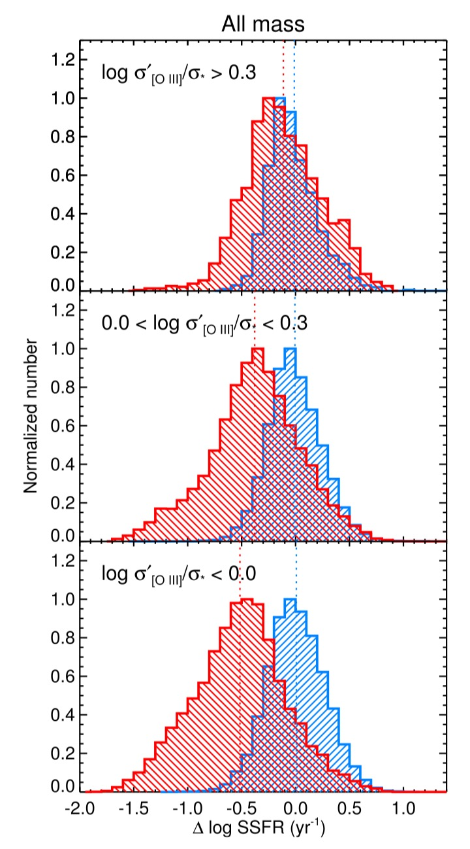
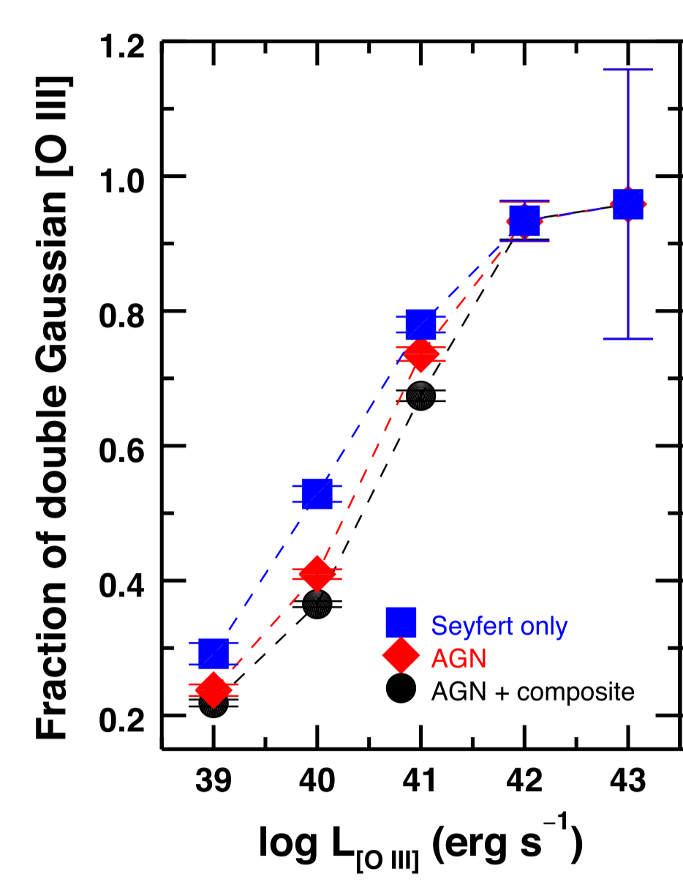
AGN driven Ionized Gas outflow in NLR
One of the possible AGN feedback Mechanism
Ubiquitous phenomenon for luminous AGNs
: Bae & Woo (2014), Woo et al. (2016), Kang et al. (2017)
Connection btw Outflow & sSFR
: Woo et al. (2017)
AGN
SF galaxies
Woo et al. 2016
Kang et al. 2017
Woo et al. 2017
Notes:
The Kpc scale gas outflow is expected to be one of the ways that SMBHs affect their host galaxy, by blowing away or suppressing gas.
Several study discovered that outflow is a common phenomenon especially for luminous AGNs.
Woo et al showed that the fraction of AGNs with outflow feature in [OIII] line profile increases as a function of [OIII] luminosity. and Kang et al also showed similar results for outflows in Ha emission line.
Moreover, the recent study showed a connection between the outflow kinematics and star formation. Woo et al. 17 showed the distribution of sSFR and found that AGNs with strong outflow have on average larger sSFR than AGNs without strong outflow.

Slide 4
AGN Feedback
Is outflow energetic enough to quench star formation?
How far can the outflow extend?
: Essential parameter to measure the mass outflow rate
Investigate structure of outflow for individual target
Spatial Distribution of physical properties
Notes:
To ensure whether the outflow is suitable as the mechanism of AGN feedback, we need to quantify how energetic it is and how far it can extend.
The size of outflow existing area what I will focus on today is one of the necessary parameters to quantify the mass outflow rate.
Therefore we need to investigate the structure of outflow for individual targets, by looking at the spatial distribution of physical properties of outflow suffering gas.

Slide 5
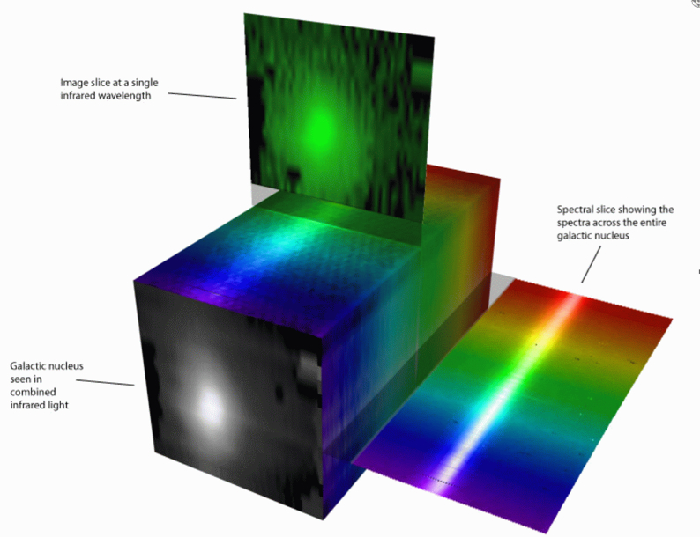
Integral Field Spectroscopy (IFS)
Spatially resolved data
Detailed Kinematics using IFS
Harrison et al. (2014)
Husemann et al. (2014)
Liu et al. (2014)
Karouzos et al. (2016a, b)
Bae et al. (2017)
Fischer et al. (2017)
A representation of a data cube.
Image credit: Stephen Todd (ROE) and Douglas Pierce-Price (JAC)
Notes:
These days we are available to examine the spatially resolved outflow physics thanks to the IFS technique. Detailed kinematics of outflow has been studied through several papers with various IFU instruments.

Slide 6
In this Study
23 luminous Type 2 AGNs at z < 0.2
Gemini Multi-Object-Spectrograph (GMOS) IFU
FOV : 3.5” x 5.0”
Kinematic outflow size
Radial profile of outflow kinematics
Kinematic size Vs. Luminosity
Comparison with photoionization size
Kinematic size Vs. Velocity dispersion
Notes:
In our study, we deal with 23 Type 2 AGNs at redshift below 0.2 using IFU mode of Gemini MOS.
We will introduce the kinematically defined outflow size, and show how far the outflow extends.
Then, we will present kinematic size-luminosity relation and compare it with previous results.

Slide 7
Selection of 23 AGNs
Observation of 9 Type 2 AGNs ( GMOS-North )
2015A, B semester in KGMT time (ID: GN-2015A-Q-204, GN-2015B-Q-92, PI: Woo)
Selected from ~ 39,000 Type 2 AGNs (Bae & Woo. 2014, Woo et al. 2016)
Z < 0.1 & extinction corrected [OIII] Luminosity > 10⁴² erg/s
Strong outflow features : |V_{[OIII]}| > 200 km/s , or σ_{[OIII]} > 350 km/s
3 targets : Kang & Woo (2018, in preparation)
6 targets : Karouzos et al. (2016a, b)
14 Type 2 AGNs ( GMOS-South )
16 AGNs from Harrison et al. (2014)
Z < 0.2 & [OIII] Luminosity > 5 X 10⁴¹ erg/s
FWHM of broad [OIII] component > 700 km/s
Exclude 2 : 14
Notes:
Before we go on to main results, I will introduce what targets we selected, and how we measured physical properties.
First, 9 of 23 AGNs are observed over 2 semesters of KGMT time in 2015.
These are drawn from parents samples in Bae & Woo 2014.
We constrained redshift up to 0.1 to obtain enough spatial resolution. These 9 AGNs are [OIII] luminous and have strong outflow features:
To expand the sample size we add 14 AGNs from Gemini archive which have similar physical properties with those 9 AGNs. These are observed and analyzed by Harrison et al. 2014.
The velocity -velocity dispersion diagram at the lower right show the overall kinematic properties of our samples.

Slide 8
Emission lines properties measurement
Data reduction using Gemini IRAF package + Pycosmic
(Husemann et al. 2012)
Stellar continuum subtraction : pPXF
(Cappellari & Emsellem 2004; Cappellari 2017)
Emission lines fitting ( [OIII], Hα, Hβ, [NII] )
: double-, or single-Gaussian
Velocity shift , Velocity dispersion
: flux weighted 1st, 2nd moments
(Woo et al. 2016, Karouzos et al. 2016a,b ,
Kang et al. 2017, Bae et al. 2017 )
Notes:
We did basic data reduction with Gemini Iraf package and removed cosmic rays using Pycosmic routine. Then we subtracted stellar continuum of each spaxel using the pPXF code,
and fit each emission line with double Gaussian or single Gaussian model depending on its line profile.
Usually, spectra in the center were fitted with double-Gaussian, and those in outer part were fitted with the single-gaussian model.
From the best fit result, we calculated velocity shift with respect to systemic velocity from flux weighted 1st moment and velocity dispersion from the 2nd moment.
This method has been used in a series of research papers in our outflow studying to quantify the gas kinematics.

Slide 9
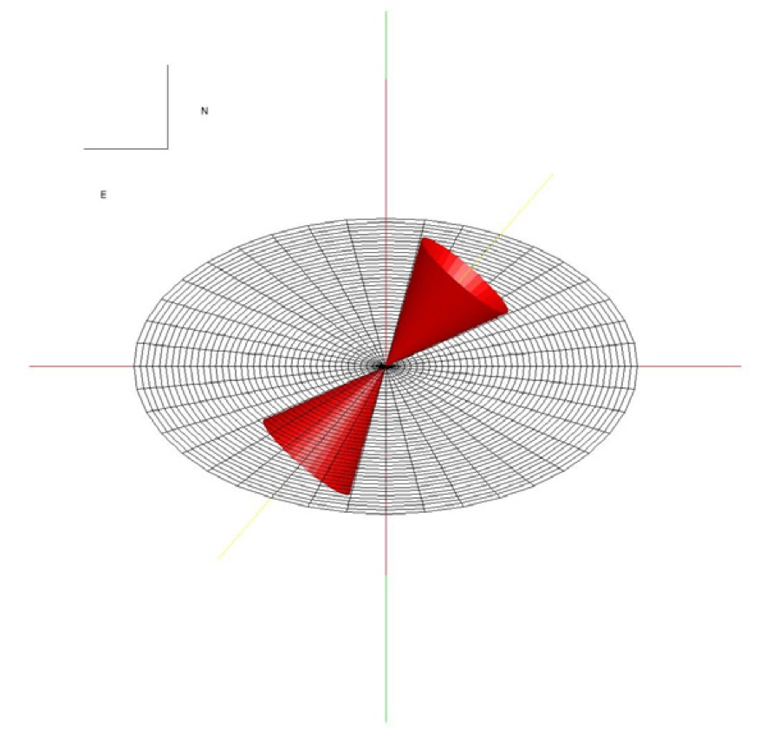
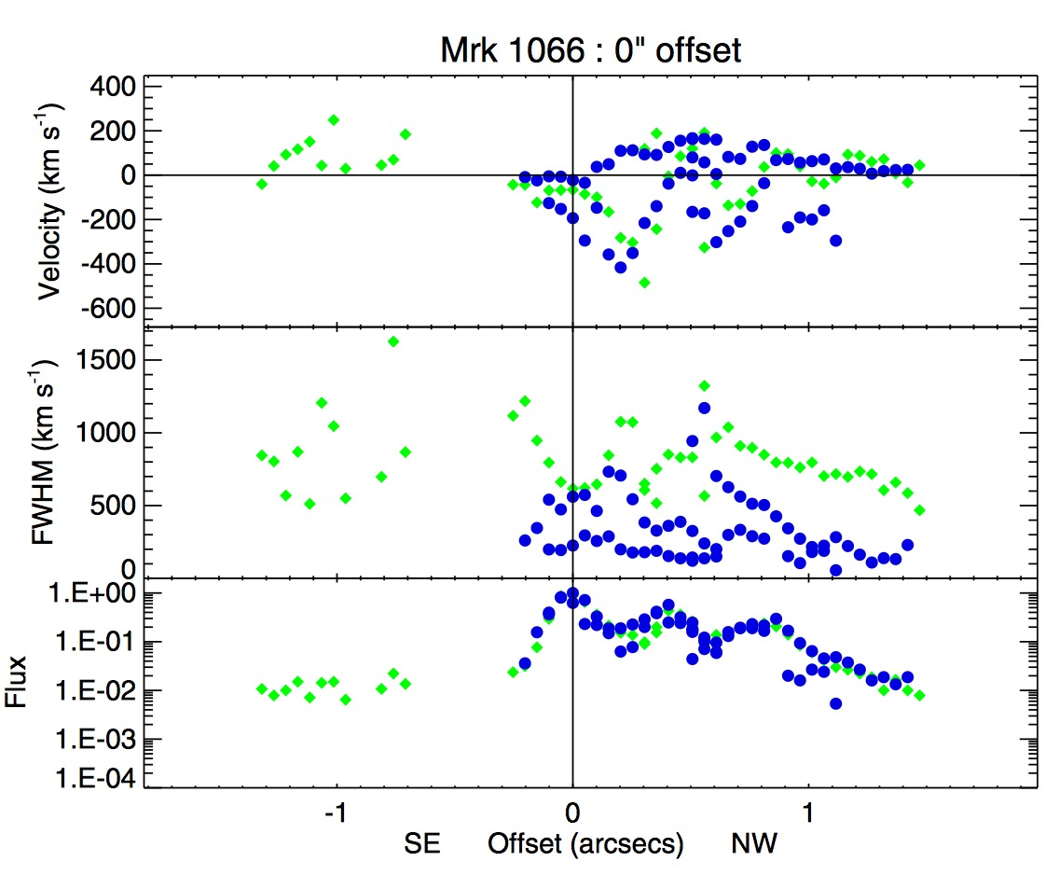
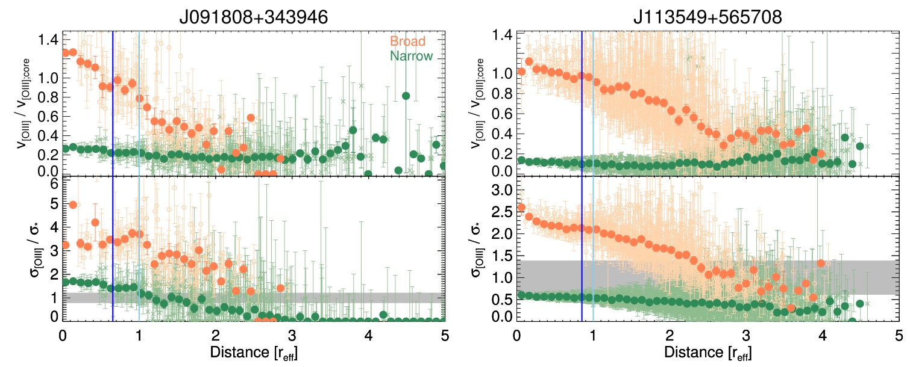
Radial profiles of kinematics
Decrement in kinematic properties
Fischer et al. 2013
Karouzos et al. 2016a
Notes:
Several studies have proved that kinematic properties decrease as a function of distance from the galactic center. Fischer et al. 2013 showed several radial profiles that show a decrement in velocity and line width.
Karouzos et al. 2016 also showed similar results that velocity shift and velocity dispersion of outflow component in the line profile decreases.

Slide 10
Kinematic size : Radial profile of σ_{[OIII]}
Outflow existing area (i.e., Kinematic size)
- use Velocity dispersion of [OIII] as an outflow tracer
- Velocity shift is a weak tracer for Type 2 AGNs (projection effect)
- Average σ_{[OIII]} larger than σ* (σ_{[OIII]} > σ* )
Notes:
Based on these trends, we define the outflow existing region using the velocity dispersion [OIII] as an outflow tracer.
Though the velocity shift also showed the decrement in the previous slide, we chose the velocity dispersion since our samples are all Type 2 AGNs. Type 2 AGNs usually show weak velocity shift due to the projection effect.
So, we define the outflow existing area where velocity dispersion of the [OIII] is on average larger than stellar velocity dispersion.
This figure shows a decreasing radial profile of the velocity dispersion of [OIII] divided by the stellar velocity dispersion. In this study, we used stellar velocity dispersion measured from SDSS spectra, which means stellar velocity dispersion is constant for each galaxy regardless of the distance of each spaxel.
Blue filled circles show the weighted average values in each distance bin. Light blue circles behind the blue one shows the values of each spaxel.
This dashed line shows the kinematic size where the [OIII] velocity dispersion becomes equal to stellar velocity dispersion.
That green box which shows the average uncertainty of the [OIII] over stellar velocity dispersion is used to calculate the uncertainty of kinematic size. We defined 1 sigma error as a standard deviation of data points inside the green box.
Measured size and error are written at upper right side here, in Kpc unit.
Vertical pink line, here, indicates the half width half maximum of Point Spread Function, the seeing size.
(residual : fit with proper polynomial )

Slide 11
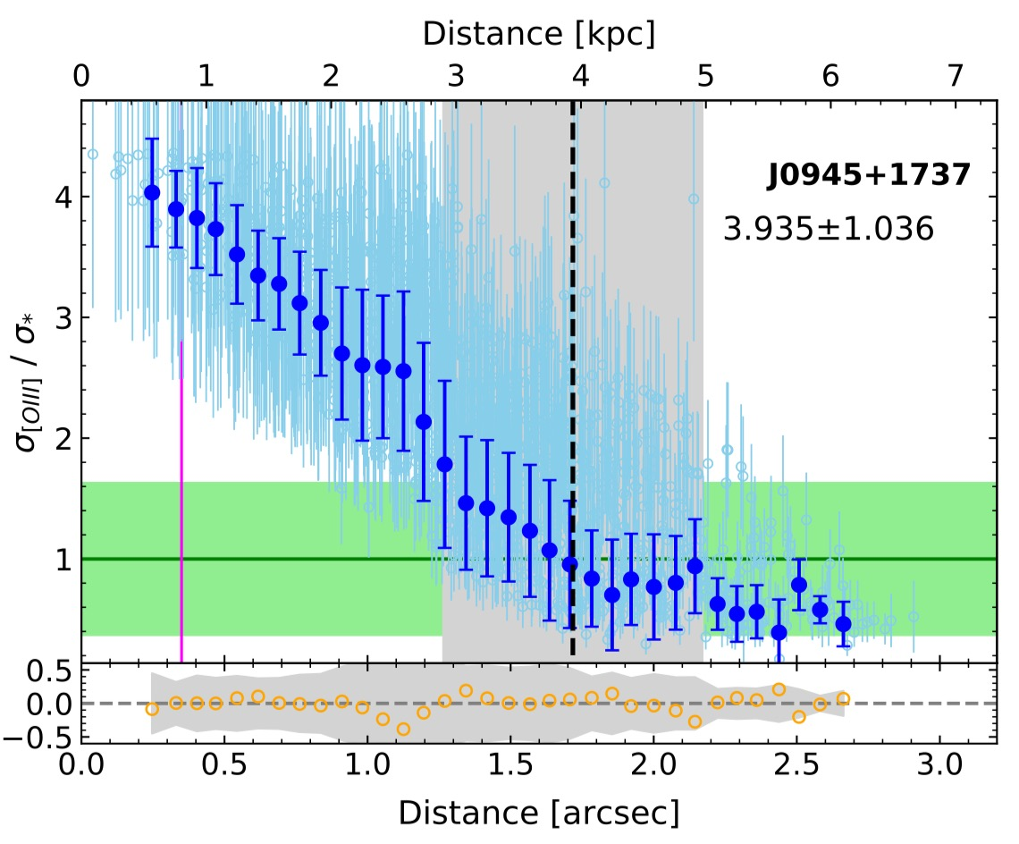
Kinematic size : Radial profile of σ_{[OIII]}
Outflow existing area (i.e., Kinematic size)
- use Velocity dispersion of [OIII] as an outflow tracer
- Velocity shift is a weak tracer for Type 2 AGNs (projection effect)
- Average σ_{[OIII]} larger than σ* (σ_{[OIII]} > σ* )
σ* is obtained from SDSS
(→ independent of distance)
Standard deviation of
data points = Error of size
Average uncertainty of σ_{[OIII]}/σ*
Seeing (HWHM)
Notes:
This figure shows a decreasing radial profile of the velocity dispersion of [OIII] divided by the stellar velocity dispersion.
In this study, we used flux-weighted stellar velocity dispersion measured from SDSS spectra
Blue filled circles show the weighted average values in each distance bin. Light blue circles behind the blue one show the values of each spaxel.

Slide 12
Kinematic size : Radial profile of σ_{[OIII]}
Outflow existing area (i.e., Kinematic size)
- use Velocity dispersion of [OIII] as an outflow tracer
- Velocity shift is a weak tracer for Type 2 AGNs (projection effect)
- Average σ_{[OIII]} larger than σ* (σ_{[OIII]} > σ* )
σ* is obtained from SDSS
(→ independent of distance)
Standard deviation of
data points = Error of size
Average uncertainty of σ_{[OIII]}/σ*
Seeing (HWHM)
Notes:
This dashed line shows the kinematic size where the [OIII] velocity dispersion becomes equal to stellar velocity dispersion.
That green box which shows the average uncertainty of the [OIII] over stellar velocity dispersion is used to calculate the uncertainty of kinematic size.
We defined 1 sigma error as a standard deviation of data points inside the green box.
Measured size and error are written at the upper right side here, in Kpc unit.
Vertical pink line, here, indicates the half width half maximum of Point Spread Function, the seeing size.
(residual : fit with proper polynomial )

Slide 13
Kinematic size : Distribution of σ_{[OIII]} / σ*
Measured kinematic size : 0.55 ~ 5.55 kpc
Kinematic size
Notes:
In this method, we examined the radial profiles and calculated the kinematic sizes for 23 AGNs.The measured outflow size ranges from 0.5 to 5.5 kpc.
2d maps plotted here, are spatial distributions of [OIII] velocity dispersion over stellar velocity dispersion.
And these circles, thick solid purple one, shows the measured kinematics size and dotted 2 circles outside and inside the tick one indicates the 1sigma size uncertainty.Some targets have symmetric outflow distributions,

Slide 14
Kinematic size : Radial profile of σ_{[OIII]} / σ*
Notes:
while some galaxies have strong outflow in certain directions.

Slide 15
Kinematic size – Luminosity Relation
L_{[OIII]} = Luminosity inside the kinematic size
Exclude 3 targets with
  Large uncertainty
  Unique kinematic features
  (radio jet, Harrison et al. 2015)
  ∴ 20 AGNs
Notes:
Then we compared the measured kinematic size with the [OIII] luminosity. The luminosity is measured from the spectrum integrated inside the kinematic size.
Among the whole 23 AGNs, we excluded 3 targets. One target has too large uncertainty in kinematic size, and the others have distinctive kinematic features that are originated from radio jet.So, we only used 20 objects for size-luminosity relation.
As we can see in the Figure, the kinematic size increases as a function of [OIII] luminosity.
We performed forward regression and obtained the slope of 0.28.
왜 이런 상관관계를 보이는지 질문이 있을 수 있음
수식은 불필요할수도(절편부분은 별로 중요하지 않으므로?)

Slide 16
Size – Luminosity Relation (NLR)
Kinematic size
Photoionization size
Effective Radius
Bae et al. 2017
- IFU, Type 2 AGNs, Slope : 0.41±0.02
Husemann et al. 2014
- IFU, Type 1 AGNs, Slope : 0.44±0.06
* Not a full photoionization size
S/N based size
Greene et al. 2011
- long slit, [OIII] S/N > 5, Slope : 0.22±0.04
Schmitt et al. 2003
- HST images, S/N limit , Slope : 0.33±0.04
Bennert et al. 2002
- HST images, S/N limit, Slope : 0.52±0.06
* Depend on the flux limit
Notes:
We compared this result with various studies which measured the size of NLR.
They defined their own sizes so the meaning of size in each paper is technically different at all. But since their sizes are all based on the flux distribution or surface brightness of [OIII], what they measured are sort of photoionization size.
These papers can be classified into two groups according to the definition of size. First, these two papers measured a flux-weighted effective radius using IFU data of Type 2 AGNs, and Type 1 AGNs respectively. And they obtained consistent results. The problem is that effective radius only represents the size of a central region, so we do not know how far the ionizing photon can go.

Slide 17
Size – Luminosity Relation (NLR)
Kinematic size
Photoionization size
Effective Radius
Bae et al. 2017
- IFU, Type 2 AGNs, Slope : 0.41±0.02
Husemann et al. 2014
- IFU, Type 1 AGNs, Slope : 0.44±0.06
* Not a full photoionization size
S/N based size
Greene et al. 2011
- long slit, [OIII] S/N > 5, Slope : 0.22±0.04
Schmitt et al. 2003
- HST images, S/N limit , Slope : 0.33±0.04
Bennert et al. 2002
- HST images, S/N limit, Slope : 0.52±0.06
* Depend on the flux limit
Notes:
The other papers define the size based on the S/N ratio of [OIII] to investigate the entire photoionization size.
In this case, a slope of size-luminosity relation varies a lot. This is due to the fact that this method largely depends on the flux limit of the observation. The longer exposure time leads the larger photoionization size.
So it is hard to strictly say whether the kinematic size-luminosity relation has steeper or shallower slope than photoionization size-luminosity relation since results vary a lot due to the definition of size, and these limitations.

Slide 18
Kinematic size Vs. Photoionization size
Effective Radius
Flux weighted size
Smaller then kinematic size
42.5
S/N based size
S/N of [OIII] > 5
Maximum photoionization
≥ kinematic size
Notes:
However, it is clear that the kinematics size is different with photoionization size regardless of the method. This Figure shows the comparison of kinematic size with photoionization size measured by 2 different methods: one is the maximum photoionization size where the S/N ratio of [OIII] is larger than 5, and the other is flux weighted effective radius.
The solid line show 1:1 relation and dashed line shows the 1:2 ratio.
We can clearly see that S/N ratio based size is similar or larger than kinematic size. while the effective radius is significantly smaller.
Therefore, if we use photoionization size to calculate mass outflow rate, it would be largely overestimated or underestimated.

Slide 19
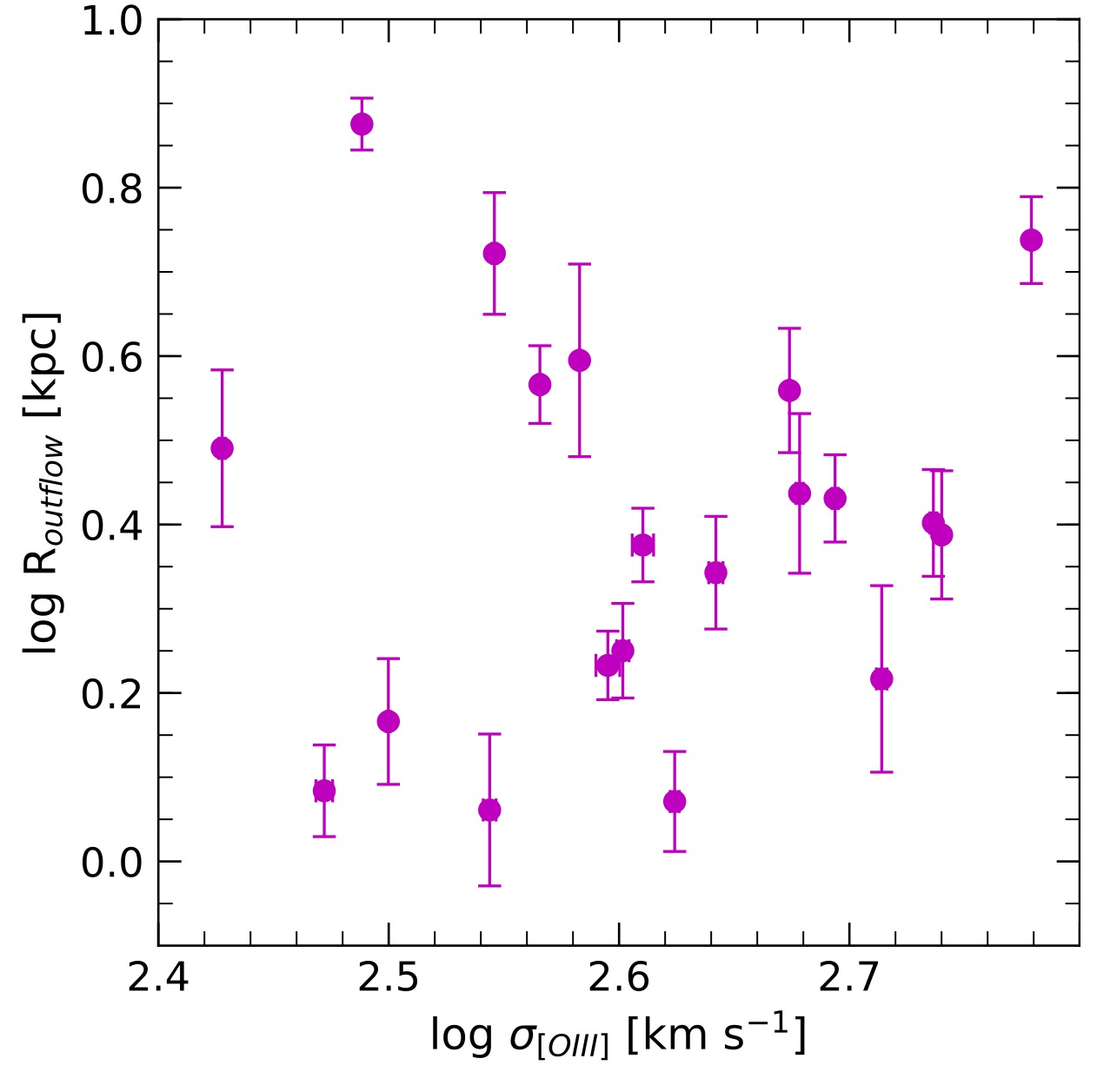
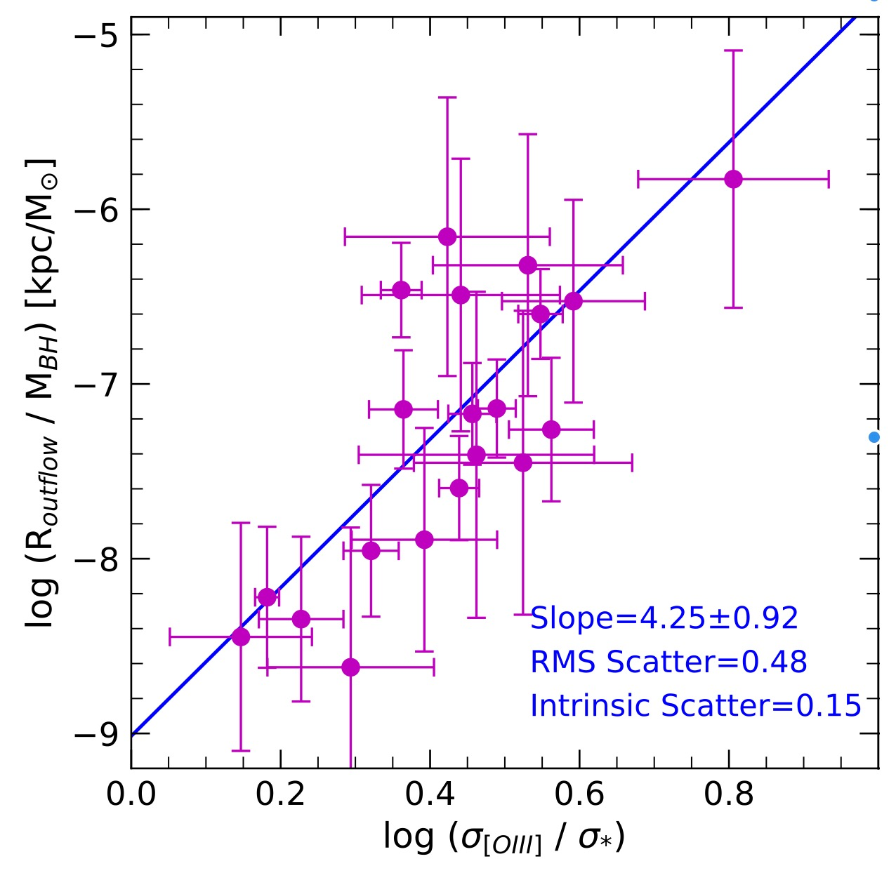
Kinematic size Vs. Kinematic property (σ_{[OIII]})
σ_{[OIII]} = Velocity dispersion inside the kinematic size
M_{BH} = BH mass from M-σ* relation (McConnell & Ma 2013)
Notes:
(34초, 12분 5초)
At last, we investigate whether the kinematic size correlates with other properties.
Kinematic size and the [OIII] velocity dispersion had no correlation.
However, when we compare the normalized velocity dispersion by stellar velocity dispersion with kinematic size divided by BH mass, it showed clear correlations albeit with large scatter. The BH mass is obtained from M-sigma relation.

Slide 20
Summary
Define kinematic size where [OIII] exhibit outflow feature
GMOS-IFU data of 23 luminous local Type2 AGNs with strong outflow features
Based on spatial distribution of [OIII] velocity dispersion
Distance where velocity dispersion decreases and becomes equal to stellar velocity dispersion
Kinematic size : 0.55 ~ 5.55 kpc
Kinematic size Vs. [OIII] luminosity
R_{OUT} ∝ L^{0.28±0.04}
Kinematic size ≤ Maximum photo-ionization size (SN > 5)
Kinematic size > Flux weighted effective radius
Kinematic size Vs. Kinematics of [OIII]
R_{OUT}/ M_{BH} correlates with σ_{[OIII]}/ σ*
Notes:
(1분 17초, 13분 22초)
This is the summary of the talk.
We used GMOS-IFU data of 23 luminous local Type 2 AGNs with strong outflow feature.
We define kinematic size based on the spatial distribution of [OIII] velocity dispersion. Kinematic size is where the [OIII] velocity dispersion becomes equal to the stellar velocity dispersion. The measured size ranges from 0.55 to 5.5 kpc.
We found that kinematic size increases as a function of [OIII] luminosity with the power law index 0.28.
The kinematic sizes are larger than the effective radius but smaller than maximum photoionization size.
This is all I prepared for today. Thank you for listening

Slide 21
Thank you !

Slide 22
Q & A

Slide 23
Radial profile of σ_{[OIII]} , σ*

Slide 24
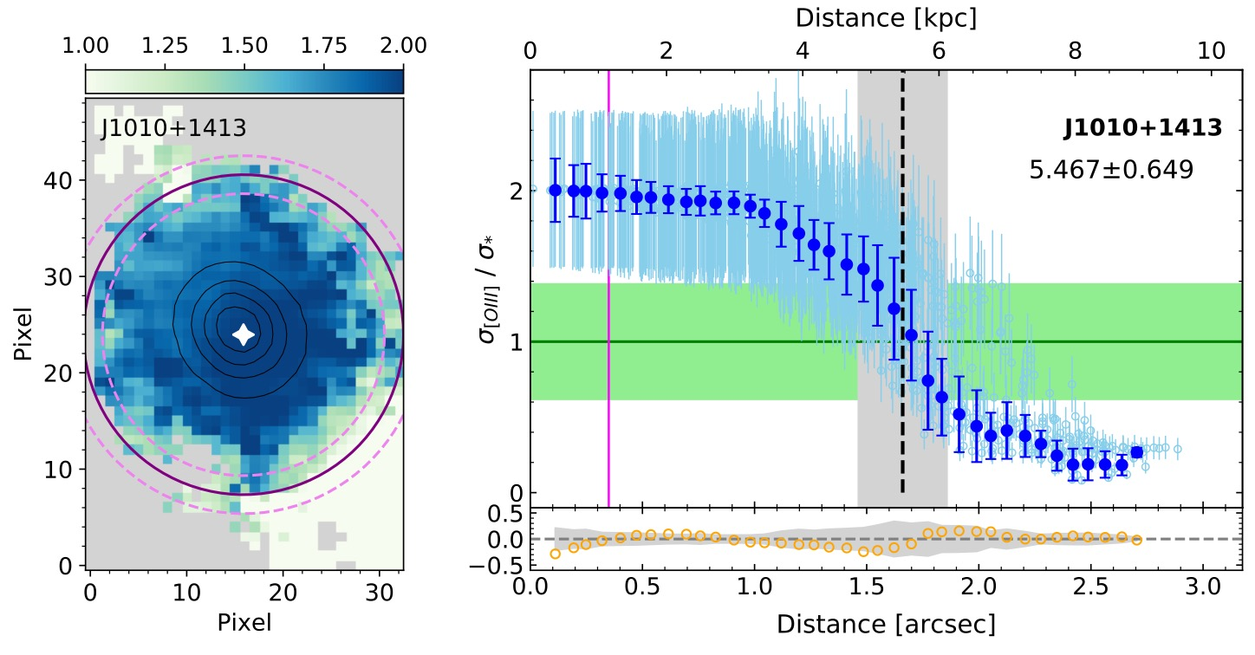
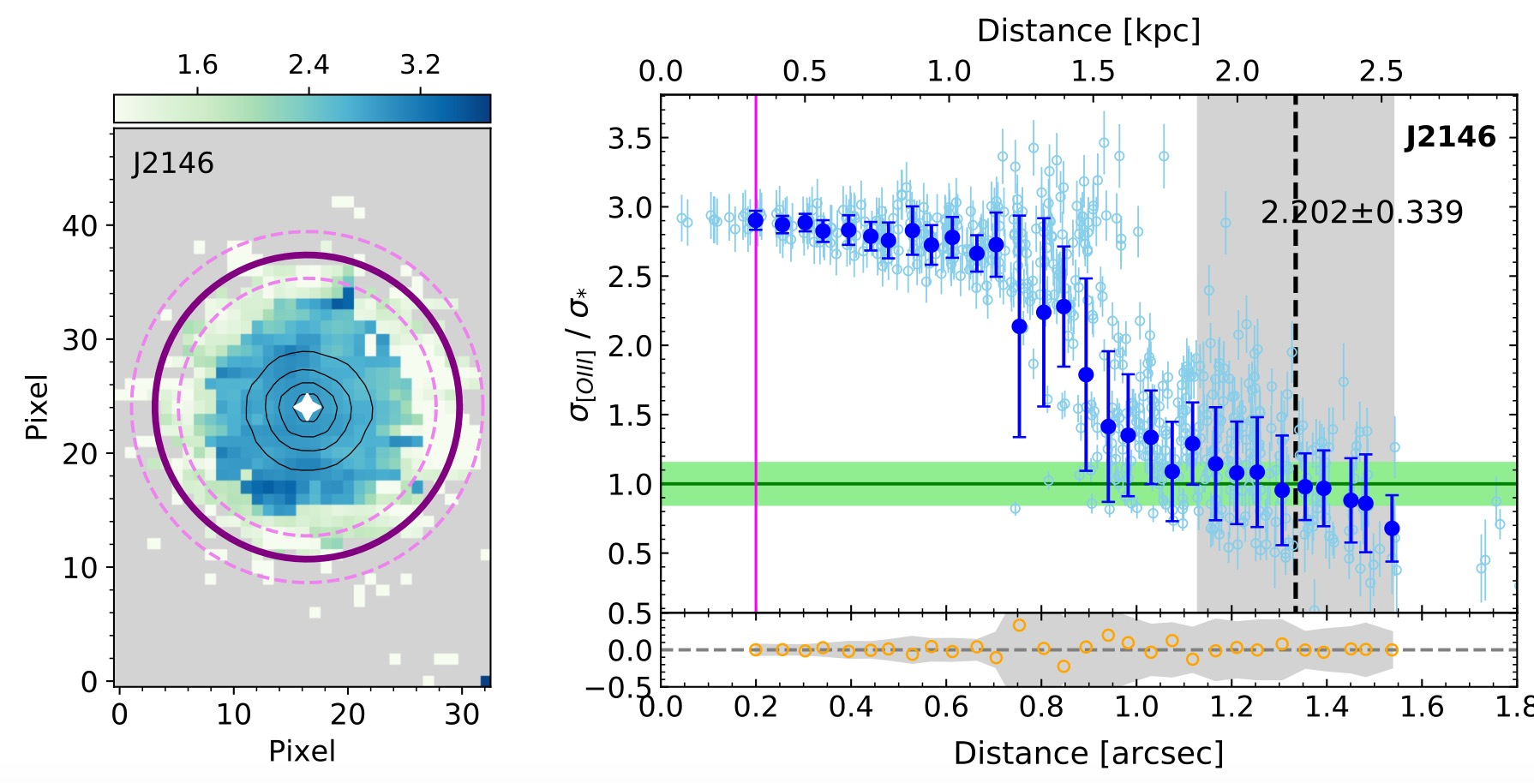
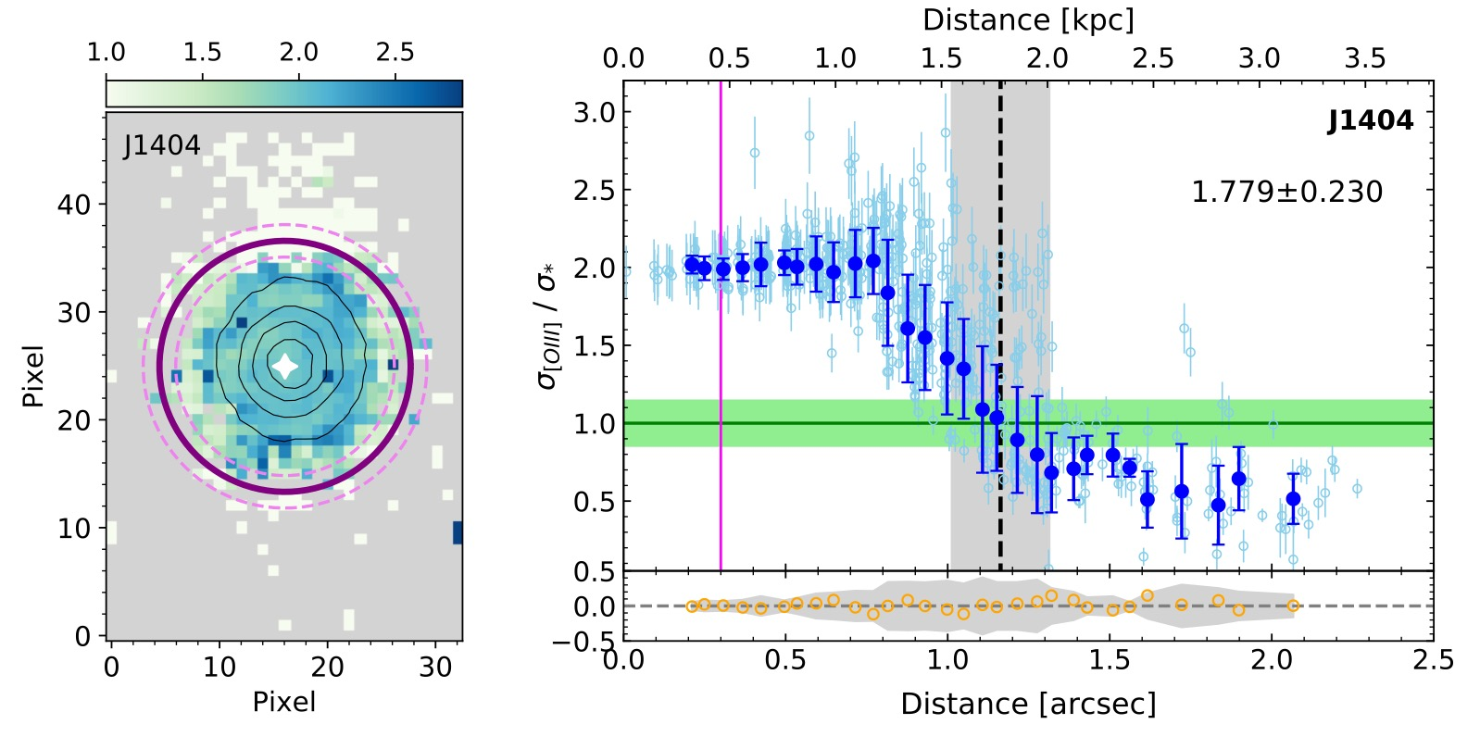
Initial Plateau : flat trend at the center
Maintaining large velocity dispersion near center
- 11 targets : over HWHM (pink line)
- 3 targets : over FWHM
- Distinctive physics in central part ?
Notes:
There is another unique feature in radial profile of velocity dispersion. Some galaxies show the flat trend in the central part. Since this can appear due to seeing effect, we checked whether this trend is extended beyond the seeing size or not. We confirmed that 11 AGNs have extended feature over the half of the seeing size, and 3 of them are more extended beyond the Full seeing size. This suggests that the outflow physics at the central part could be somewhat different to the outer region.

